Slide 1

Living the DREAM

Slide 2


Slide 3


Slide 4


Slide 5
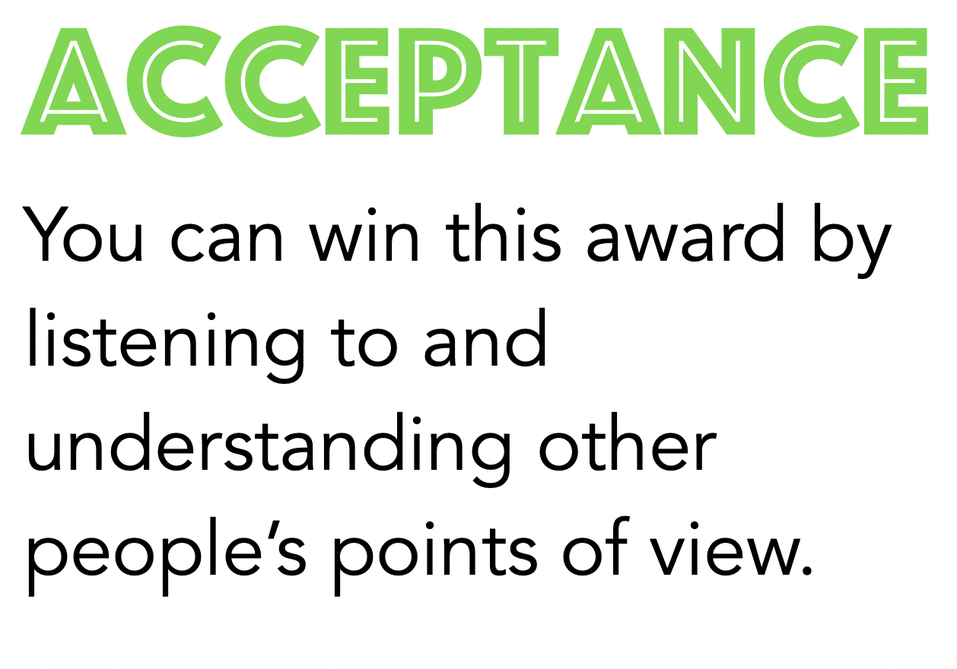

Slide 6


