Slide 1



English and Maths at Primary School - an insight for parents

Slide 2
Purpose
The purpose of this evening’s session is to give parents an insight into how we teach English and Maths so that you know what your children experience every day at school.

Slide 3
English
Our children have daily English lessons, which include a range of key elements. In Early Years and Key Stage 1, there is a strong emphasis on early reading, phonics, and early writing, including sentence structure and the development of grammatical understanding.
In Key Stage 2, children build on these foundations by exploring a wider range of texts and writing genres, while refining their skills in spelling, punctuation, and grammar.
English skills are embedded across the curriculum. Children use reading to learnabout historical figures, to understand mathematical problems, and to record and explain their findings in science.

Slide 4

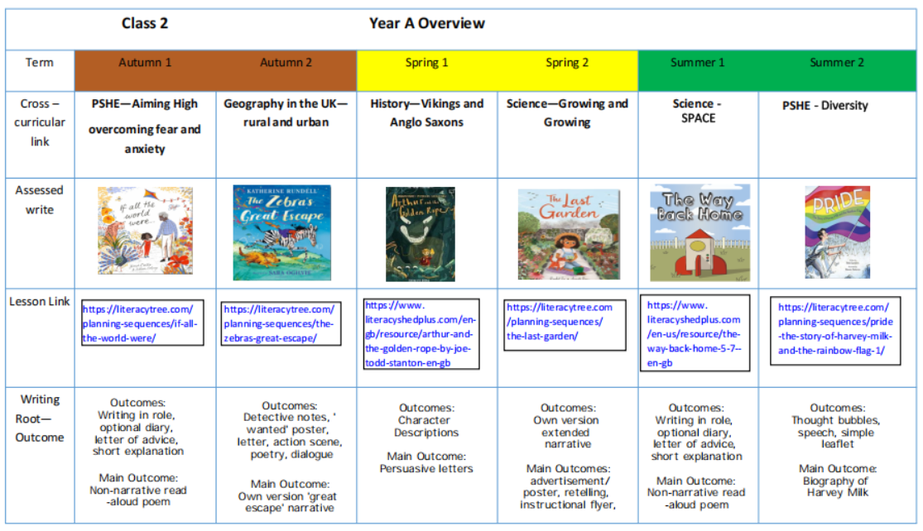

Slide 5
What does early English look like in pre-school?

Slide 6
What does early English look like in our pre-school?
We are giving the children early skills required for oracy and writing.
Pre-school children learn best through their senses: touch, sound and sight. Our environment reflects all of these.
A language rich environment/ensuring letters and words are visible net to a picture around the room. For example, on our toy boxes, phonics table, at the sink and snack table etc.
Extending the children’s vocabulary each day through stories, singing and interactions.
Interactions involving sustained shared thinking, a process of back-and-forth conversations between and adult and child. Repetition and extension in what we say.

Slide 7
What does early English look like in pre-school?
Word of the week is used to expand a child’s understanding and range of vocabulary.
Daily phonics sessions along with a phonics table, offering children opportunities to always access phonics.
Ensuring mark making is available in more than one area of provision. The more opportunities the more exposure.
Mark making is using different resources to make those early marks
Early writing in pre-school is a process, holding a pencil and writing letters is the last part of early writing with us.

Slide 8





How do we put this into practice?
Combining and refining fine and gross motor
We begin with gross motor movements; these are large movements. We use big pieces of paper so they can explore moving with their whole bodies, high up, low down and side to side. Ribbons, larger objects to grasp, pushing and pulling.
Fine motor (small movements) the children use their fingers to manipulate objects. We use a range of movements in our activities, we build finger strength by doing dough gym, we squeeze, nip (2 fingers), pinch (3 fingers), squash, poke, twisting, and pressing.
We explore making marks through our fingers and hands first, we use paint, sand, flour, lentils, rice, soil and slime to name a few.
We later move onto holding tools such as sticks, straws, cars, chalks, paint brushes, stamps.
Once they have mastered all of these, the children begin to explore the marks they make with a pencil, they gain an understanding that print carries meaning.
GRIP and FLIP!

Slide 9
What does English look like in Reception and Year 1?

Slide 10
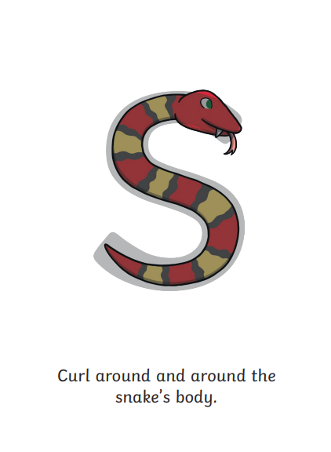
First Step
Mark making – becoming recognisable as letters.
Twinkl rhymes are used to help with letter formation.
Activity 1:
1 minute challenge

Slide 11
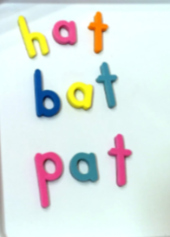
Second Step
Building words – introduced through the phonics session.
Through blending and segmenting.
Activity 2:
2 minute challenge

Slide 12
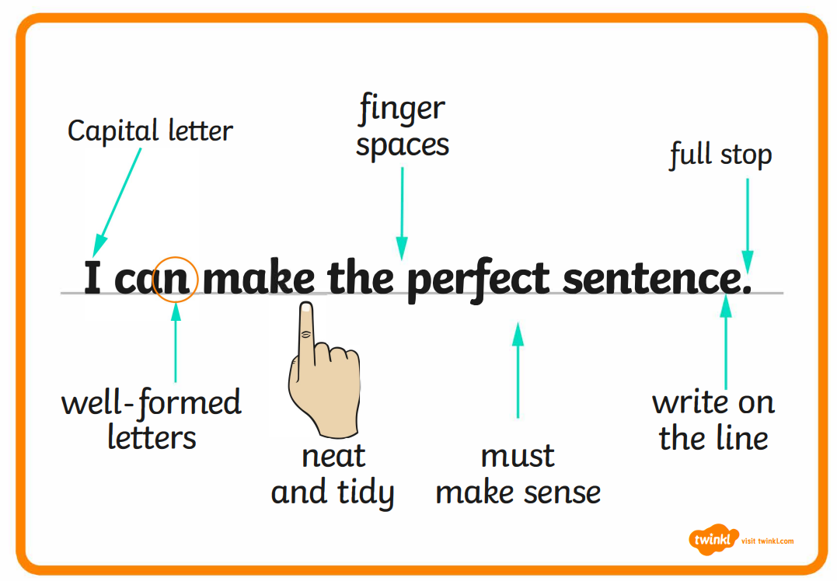
Third Step
Moving into Year One
Introducing sentences with our focus being on:
Capital letters
Finger spaces
Full stops
Activity 3:
Golden sentences

Slide 13
What does English look like in Year 2, 3 and 4?

Slide 14
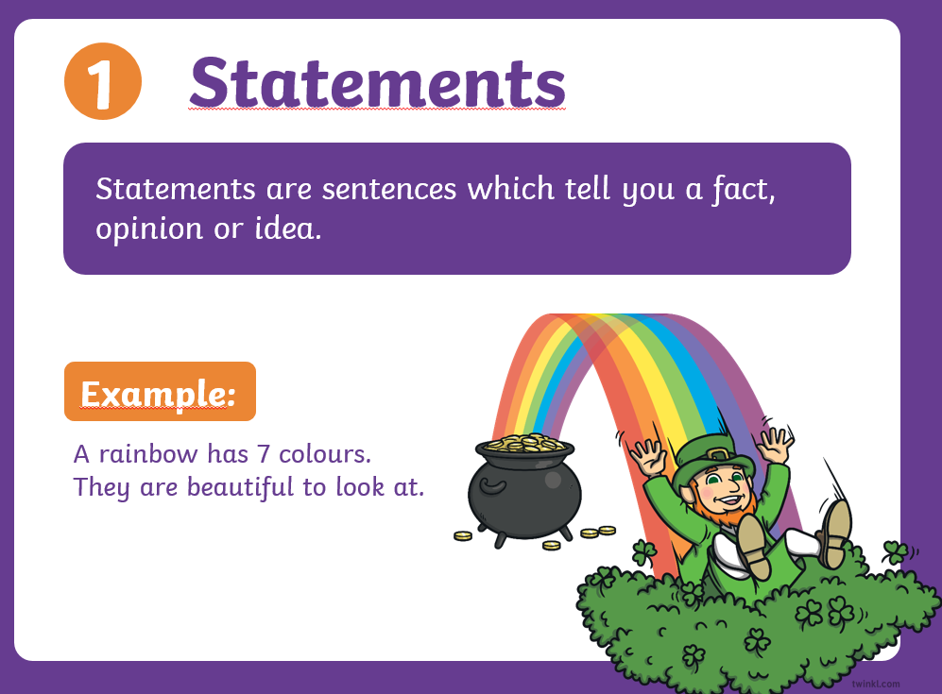
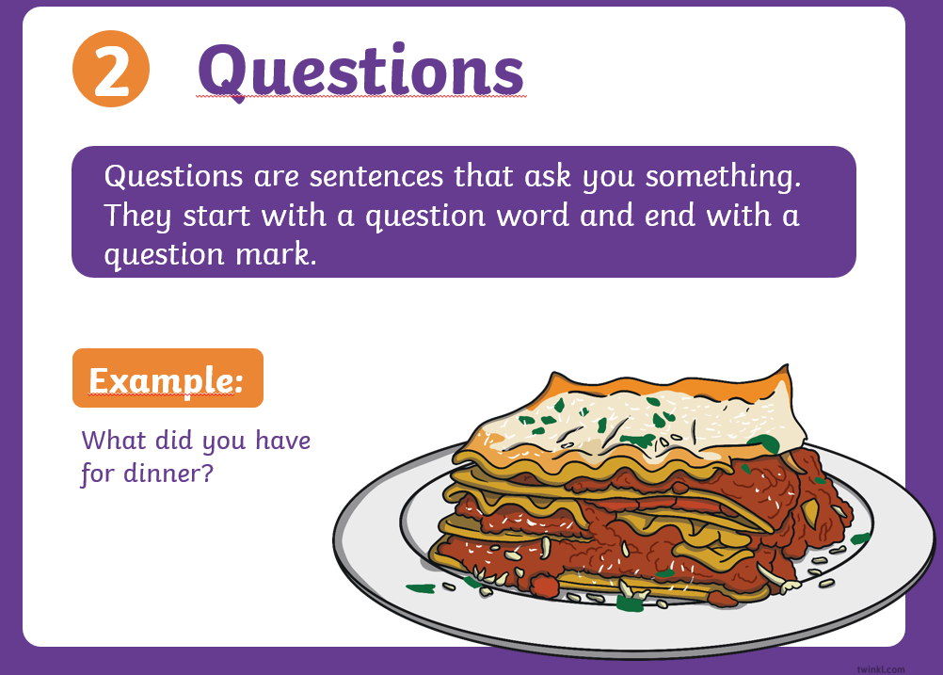
In Year 2, children develop their writing by creating different types of sentences and using them for different purposes. They learn to write 4 types of sentences; statements, exclamations, questions and commands.

Slide 15
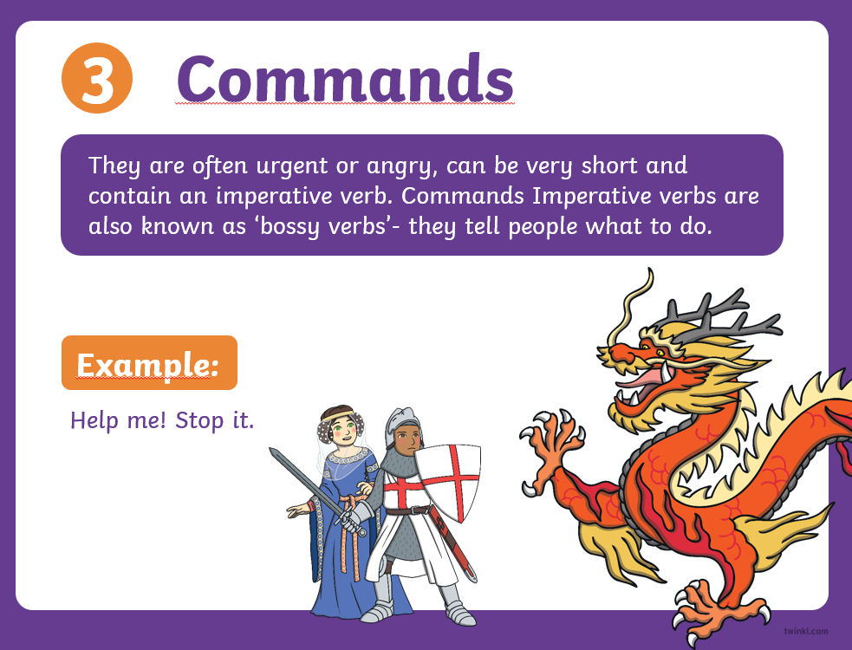
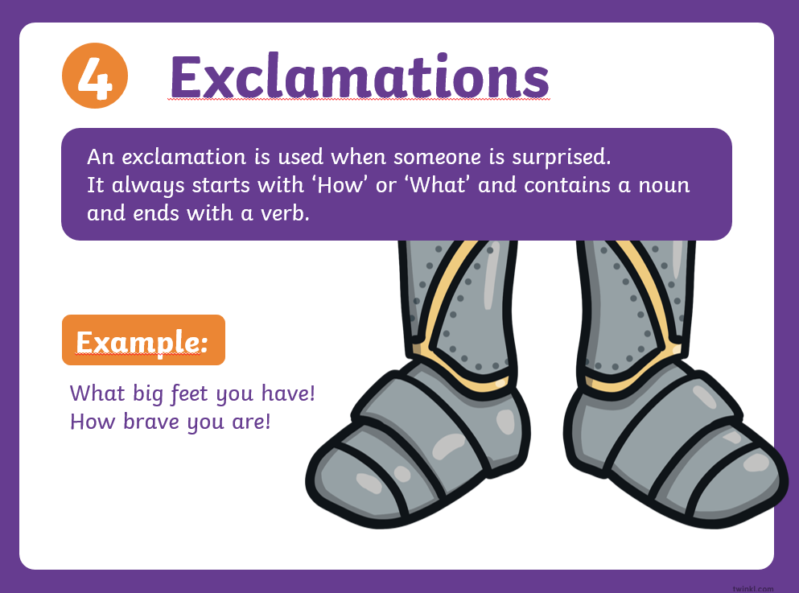

Slide 16
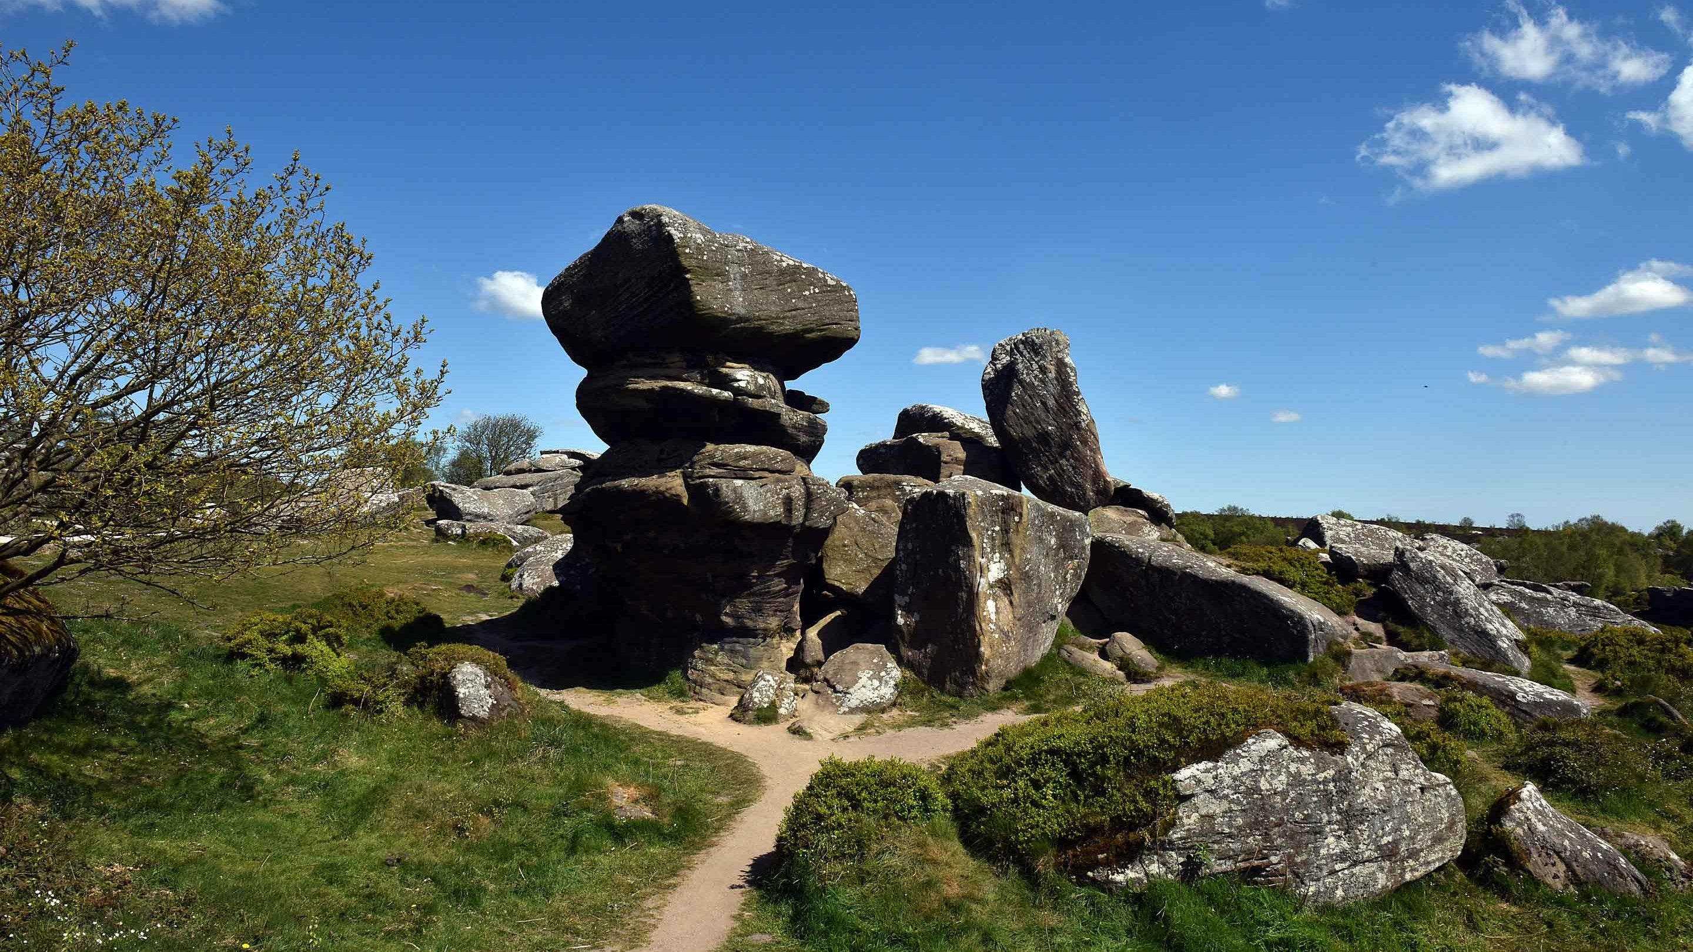
What type of sentence is it?
Statement, command, question, exclamation ?
Don’t climb on the rocks!
What a beautiful place it is!
Brimham rocks were formed 100 million years ago.
Why are the rocks such unusual shapes?

Slide 17
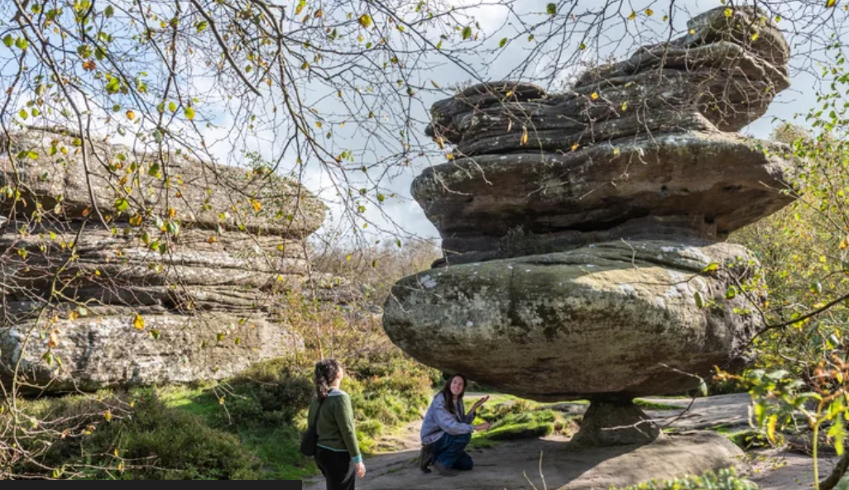
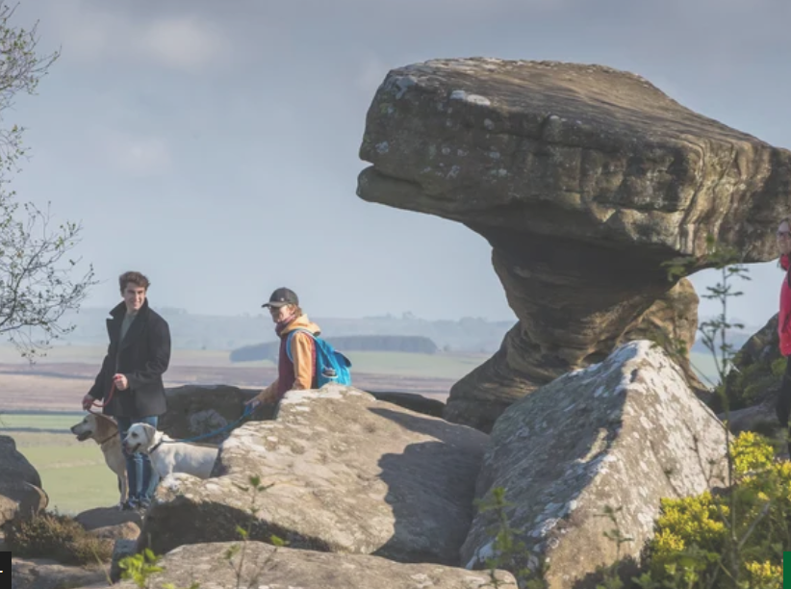
Can you have a go at writing one of the 4 different sentence types about this picture?

Slide 18
In Year 3 and 4 children continue to develop their writing and begin using more complex multi- clause sentences.

Slide 19
How to help your child
Encourage your child to use these different types of sentences in their own writing or when practicing their weekly spelling words. Check that they are using the correct punctuation.

Slide 20
What does a wrting lesson look like in Year 5 and 6?

Slide 21
Where do we need the pupils to be?
Transcription
Almost entirely grammatically correct, allowing for occasional punctuation and spelling errors.
Capitals, full stops, commas, apostrophes and question marks are all mostly accurate.
Uses the full range of punctuation to include evidence of dashes, brackets, hyphens, semi-colons and colons.
Handwriting should be neat, joined and legible.

Slide 22
Improving Punctuation
Improve the following sentences by adding punctuation in the correct places and correcting any spellings.
as the dragons awoke from there deep sleep they didnt notice the courageous valiant nights approaching
while creeping slowly forward the nights gauntlets tightly rapped around there sword hilts they were ready to strike

Slide 23
Improving Punctuation
As the dragons awoke from their deep sleep, they didn’t notice the courageous, valiant knights approaching.
Whilst creeping slowly forward, the knights’ gauntlets tightly wrapped around their sword hilts: they were ready to strike.

Slide 24
Improving Composition
Improve the following sentence by adding adjectives, and a relative clause.
For example:
The teacher despaired at the lack of punctuation in the sentence.
The exhausted teacher, who had worked tirelessly, despaired at the lack of punctuation in the sentence.

Slide 25
Maths
Our children have a daily Maths lesson and this also comprises many elements. In Early Years and KS1 a lot of work goes into number recognition, place value and developing early skills in the four operations (addition, subtraction, multiplication and division). In Key Stage 2, mathematical understanding becomes more complex; as well as building on the fluency of the four operations, children begin to learn much more complex mathematical concepts such as algebra, fractions, decimals, percentages, co-ordinates and multi-step word problems.

Slide 26
What does maths look like in pre-school?
We are where it all begins! We are giving our children the early skills they need.
Intense focused activities
We equip the youngest of children with a love for learning because its fun and engaging
Through hands on experiences
Natural curiosity and exploration
Through daily exposure

Slide 27
What does maths look like in pre-school?
Through conversations and high quality interactions
Correct use of mathematical language
Building and adapting to a child’s interests which makes it engaging
Core provision area provided for maths which has a main focus each week
We look at numerals 1-5 only, ensuring a deep understanding of each number, using forms of representation, subitising, amounts, counting aloud etc
Environmental maths, go for a walk, count conkers, look for numbers on doors, colours of leaves and shapes of signs etc

Slide 28
More & Less learning in Pre-School
EXPOSURE! It’s always intertwined and thread through all that we do, we may count the steps as we go down to the hall, we would say 1,2 and one more 3!
You could try this at home, examples……. count the stairs, count the plates and cups, count socks, shoes etc
All resources are visually stimulating and the children have hand on experience with the resources to maintain focus.
Using hand gestures to support understanding (more-add/less-take away)
Language used ‘More’, ‘Less’, ‘Same’

Slide 29
More & Less learning in Pre-School
Ask questions such as “can you give me one more” “Which one has less?” how do you know? “3 is greater/bigger/more than 2”
The children use their skills of subitising to recognize amounts.
We show this in many ways such as with items or in water play, it will be which cup has more water, which has less, can you make them the same? An Autumn walk to collect leaves, who has more leaves in their bucket? Who has the least or less?
Repetition
Adapt on the spot and follow a child’s lead

Slide 30

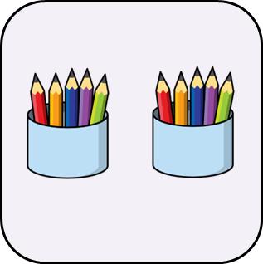
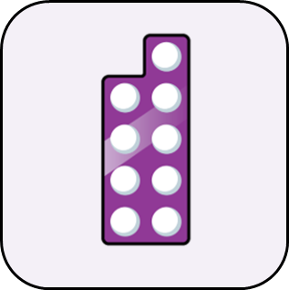
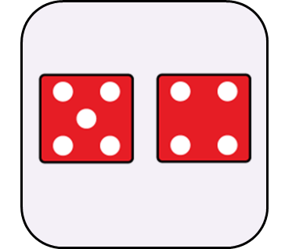

What does a Maths lesson look like in Reception and Year 1?

Slide 31
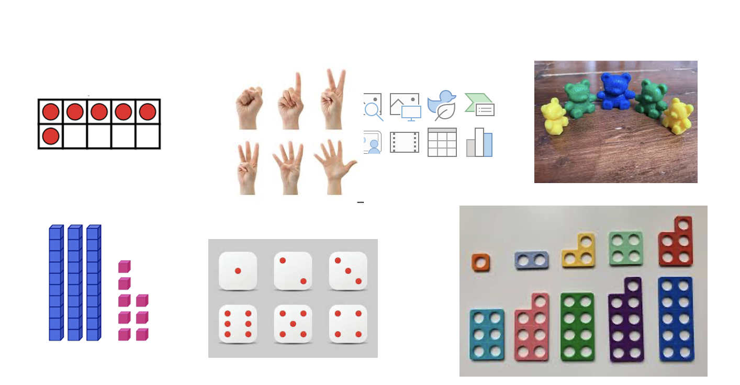

Slide 32
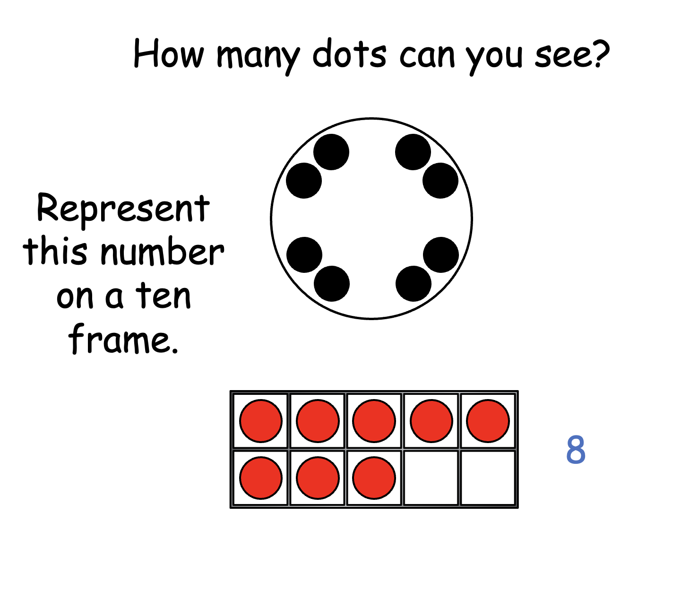

Slide 33
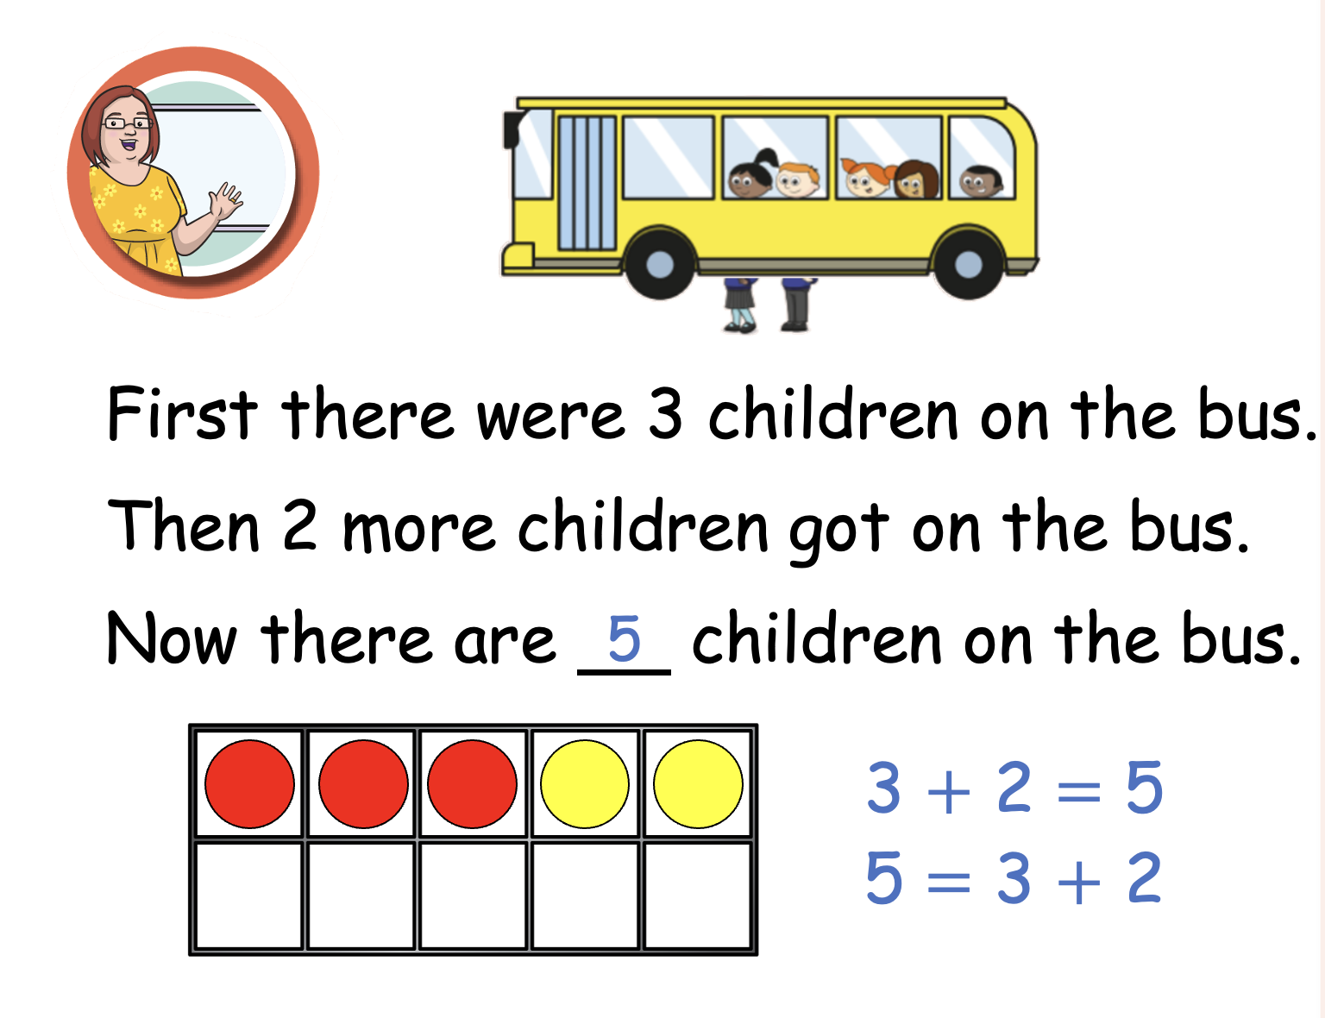

Slide 34
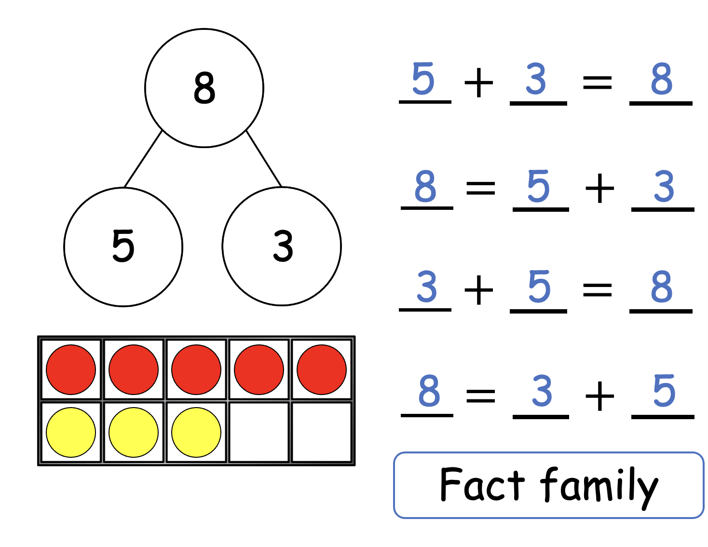

Slide 35
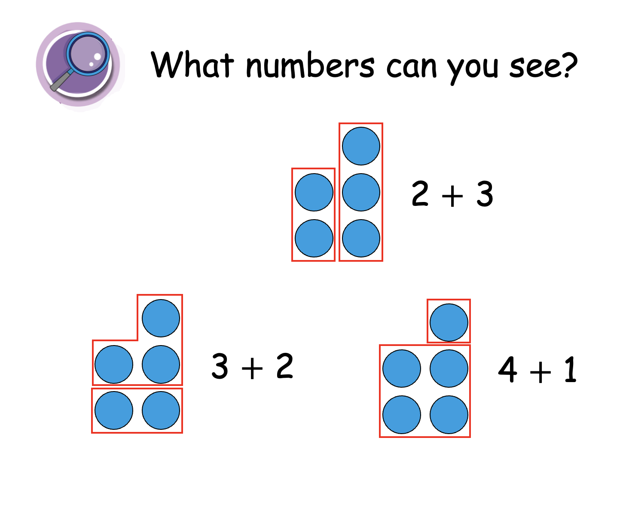

Slide 36
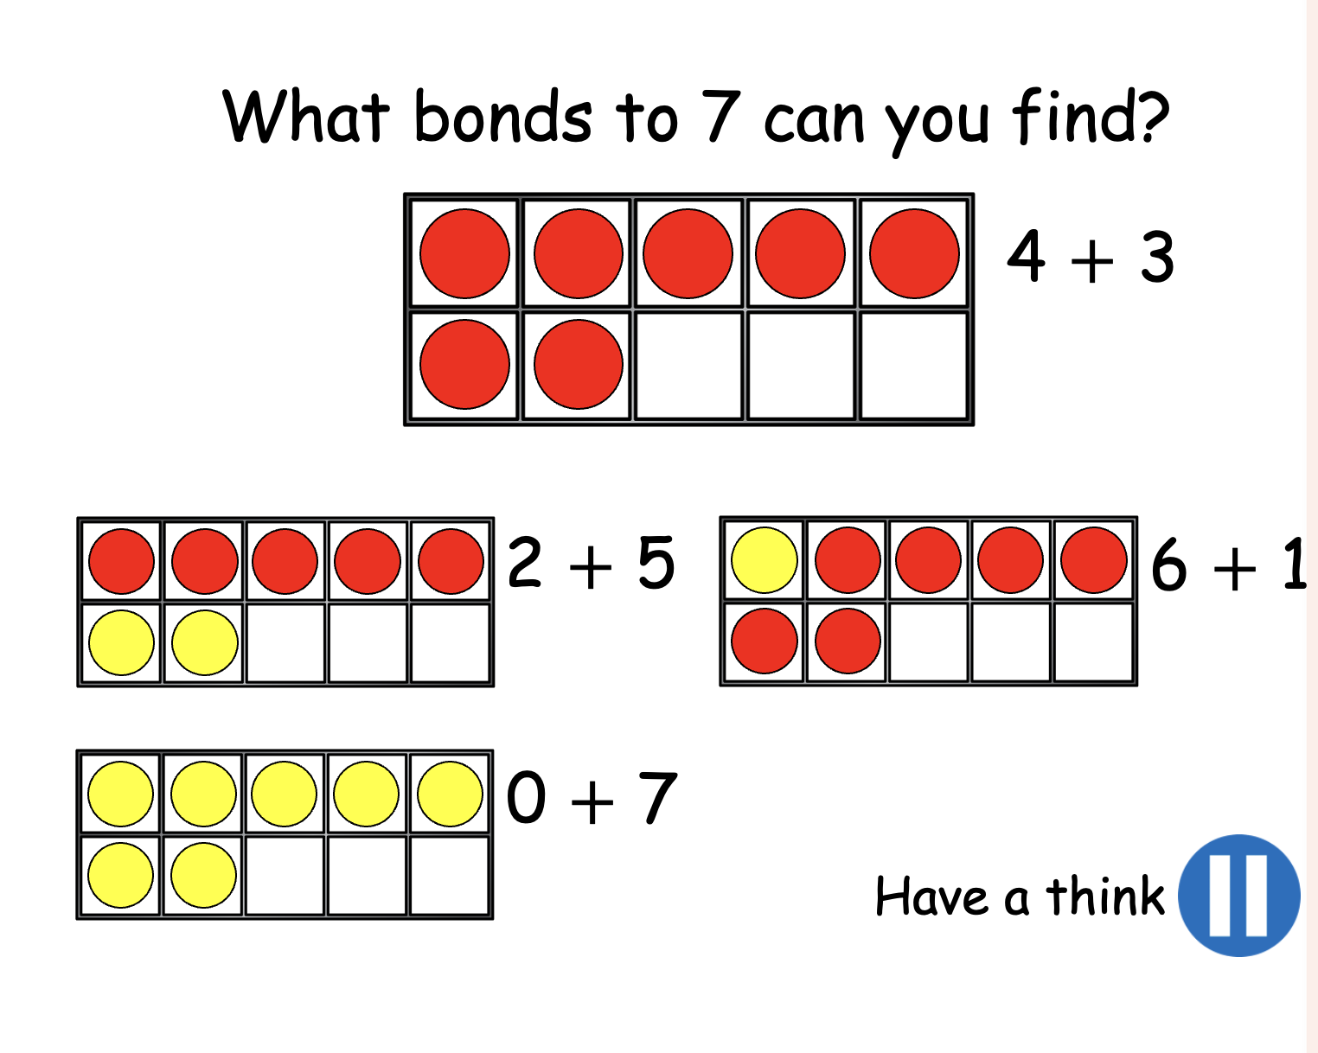

Slide 37
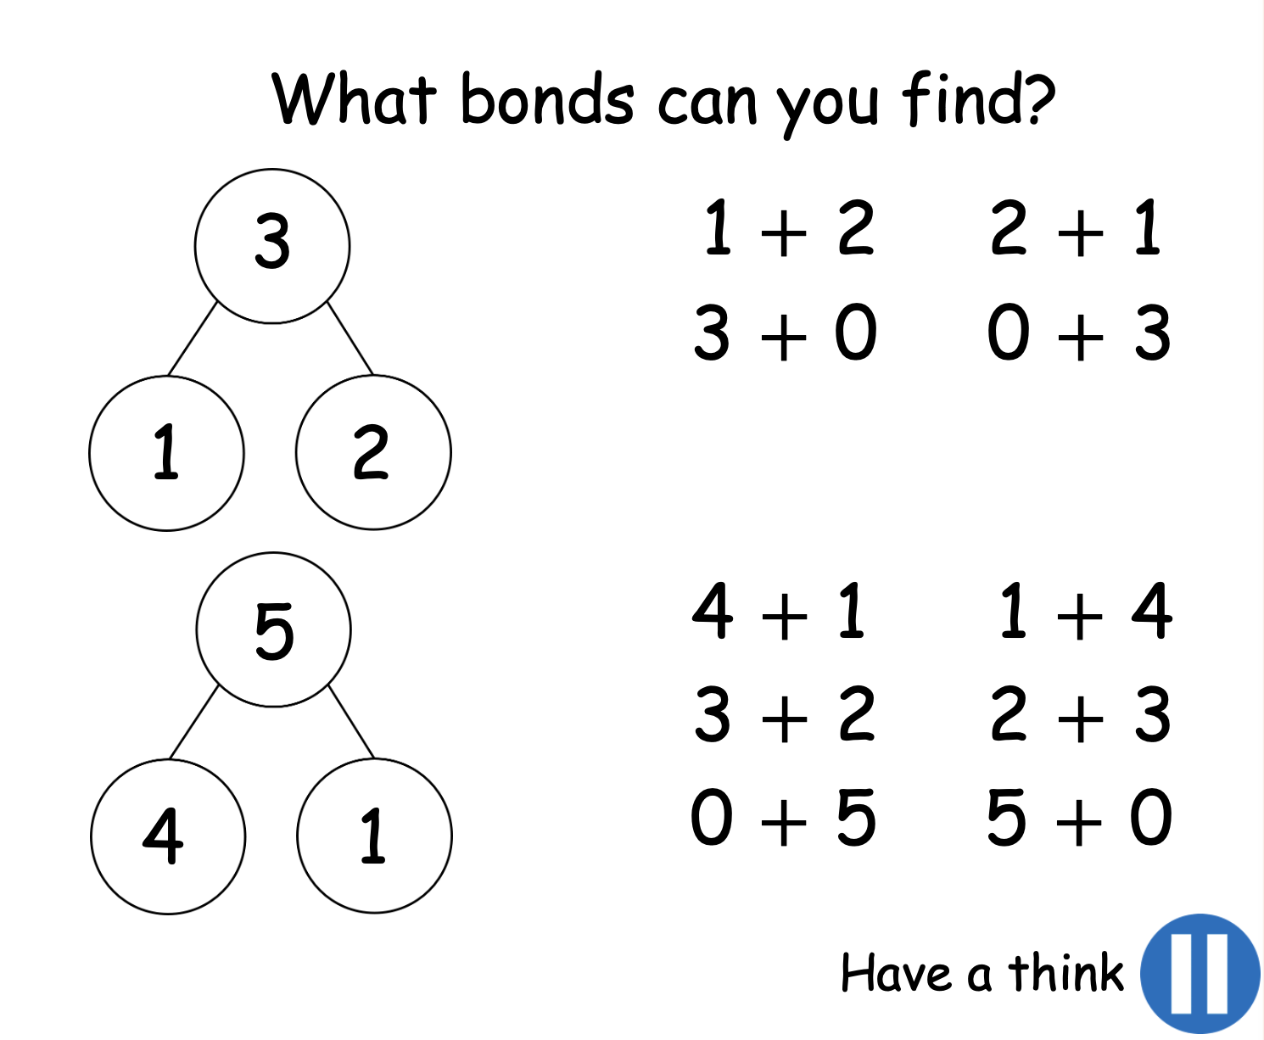

Slide 38
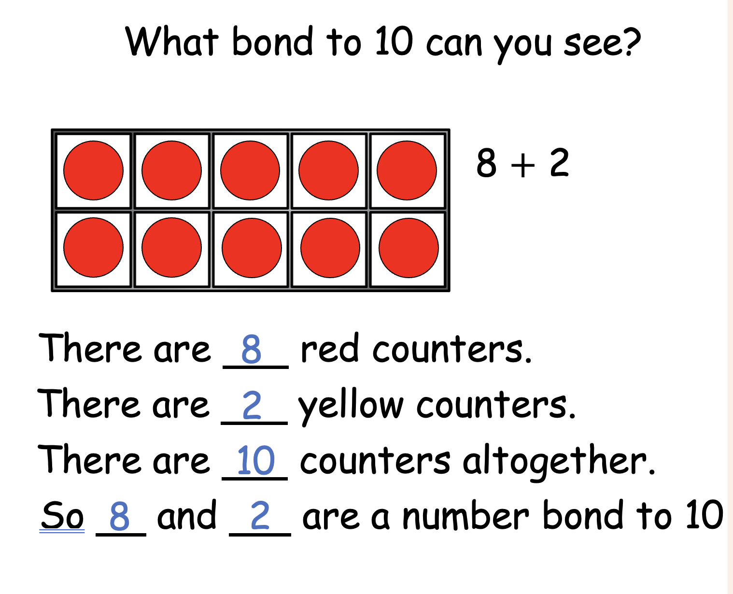

Slide 39
How do we teach addition and subtraction in Year 2, 3 and 4?

Slide 40
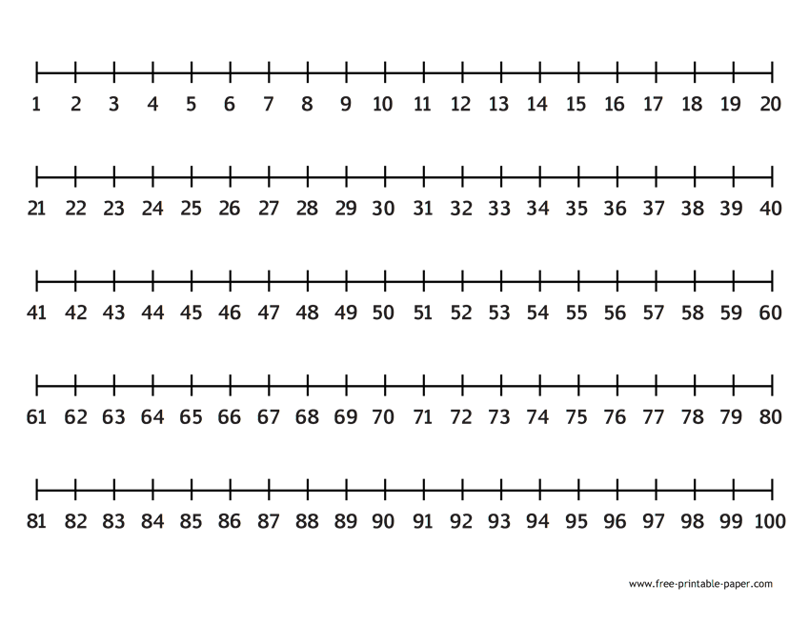
We begin, in Year 2, to look at numbers up to 100 and work towards adding and subtracting these using different methods, including number lines, pictorial representations and by Year 3 and 4, column method.
We begin by looking at labelled number lines to reinforce the linear concept of number
43 + 6 =
49
72
76 – 4 =

Slide 41
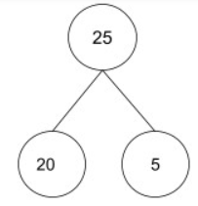
We then move on to blank number lines so that children can calculate with much larger numbers.
43 + 25 =
68
43
53
63
64
65
66
67
68
87 - 25 =
62
62
63
64
65
66
67
77
87

Slide 42
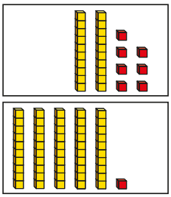
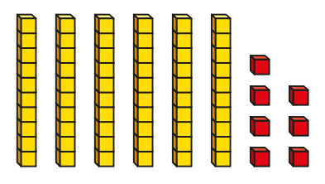
We will also use concrete and pictorial representations to support understanding of place value which leads children towards using a column to add and subtract. This is very useful for Years 3 and 4 who would also use these representations for 3-digit and 4-digit numbers.
27 + 51 =
78
67 - 21 =
46
40
6
70
8

Slide 43
Can you try using one of these methods to solve these calculations?
47 + 21 = 85 – 32 =
57 + 45 = 96 – 43 =

Slide 44
What does an addition and subtraction lesson look like in Year 5 and 6?
In upper key stage 2, we build on the skills taught in the younger classes. We continue to use the practical resources but begin to move to a more pictorial and written method of calculation.

Slide 45


243 $+$ 172 $=$
415
Hundreds | Tens | Ones
 | H | T | O
 | 2 | 4 | 3
 | 1 | 7 | 2
$$+$$
4
1
5
1
4
11
5
1

Slide 46




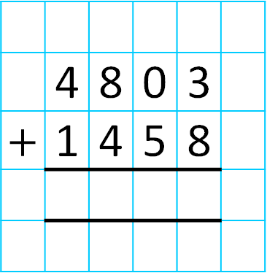
Th | H | T | O
 | 4 | 8 | 0 | 3
$+$ | 1 | 4 | 5 | 8
$$+$$
6
2
6
1
1
1
6
2
6
1

Slide 47
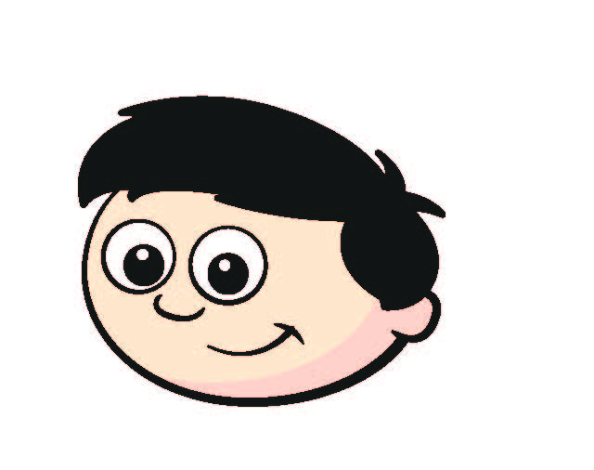

On Monday, Dexter scores 411 points.
On Tuesday he scores 63 points fewer than on Monday.
How many points does he score on Tuesday?
348
Monday
411
H | T | O
4 | 1 | 1
 | 6 | 3
3
1
63
0
Tuesday
348
?
1
$$−$$
3
4
8

Slide 48
On Monday, Dexter scores 411 points.
On Tuesday he scores 63 points fewer than on Monday.
How many points does he score on Tuesday?
348
Dexter needs to score 1,000 points by the end of Wednesday to win a prize.
How many points does he need to score on Wednesday?
H | T | O
4 | 1 | 1
3 | 4 | 8
1,000
M = 411
T = 348
W = ?
+
7
5
9
759

Slide 49
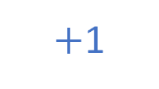
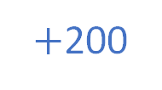
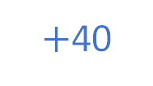
On Monday, Dexter scores 411 points.
On Tuesday he scores 63 points fewer than on Monday.
How many points does he score on Tuesday?
348
Dexter needs to score 1,000 points by the end of Wednesday to win a prize.
How many points does he need to score on Wednesday?
241
$+$1
$+$40
$+$200
1,000
M = 411
T = 348
W = ?
759
760
800
1,000
759

