Slide 1



English and Maths at Primary School
- an insight for parents

Slide 2
Why are English and Maths so important?

Slide 3
Purpose
The purpose of this evening’s session is to give parents an insight into how we teach English and maths so that you know what your children experience every day at school.
We cannot possibly cover the entire English and maths curriculum, so this evening we will focus only on how we teach writing and addition/subtraction.

Slide 4
How are English and Maths taught?
How we teach the children is determined by their age and by national curriculum expectations. Understandably, levels of challenge increase as the children get older from pre-school to Year 6.

Slide 5
English
Our children have a daily English lesson and this comprises many elements. In Early Years and KS1 there is a big emphasis on early reading, phonics and early writing such as sentence structure and development of grammatical understanding. In Key Stage 2 children expand their understanding of a range of texts and writing genres as well as refining skills in spelling, punctuation and grammar.

Slide 6
What does early English look like in pre-school?

Slide 7
What does early English look like in pre-school?
We are giving the children early skills required for oracy and writing.
Pre-school children learn best through their senses: touch, sound and sight. Our environment reflects all of these.
A language rich environment/ensuring letters and words are visible net to a picture around the room. For example on our toy boxes, phonics table, at the sink and snack table etc.
Extending the children’s vocabulary each day through stories, singing and interactions.
Interactions involving sustained shared thinking, a process of back and forth conversations between and adult and child. Repetition and extension in what we say.

Slide 8
What does early English look like in pre-school?
Word of the week is used to expand a child’s understanding and range of vocabulary.
Daily phonics sessions along with a phonics table, offering children opportunities to access phonics at all times.
Ensuring mark making is available in more than one area of provision. The more opportunities the more exposure.
Mark making is using different resources to make those early marks
Early writing in pre school is a process, holding a pencil and writing letters is the last part of early writing with us.

Slide 9





How do we put this into practice? Examples
Combining and refining fine and gross motor
We begin with gross motor movements; these are large movements. We use big pieces of paper so they can explore moving with their whole bodies, high up, low down and side to side. Ribbons, larger objects to grasp, pushing and pulling.
Fine motor (small movements) the children use their fingers to manipulate objects. We use a range of movements in our activities, we build finger strength by doing dough gym, we squeeze, nip (2 fingers), pinch (3 fingers), squash, poke, twisting, and pressing.
We explore making marks through our fingers and hands first, we use paint, sand, flour, lentils, rice, soil and slime to name a few.
We later move onto holding tools such as sticks, straws, cars, chalks, paint brushes, stamps.
Once they have mastered all of these, the children begin to explore the marks they make with a pencil, they gain an understanding that print carries meaning.
GRIP and FLIP!

Slide 10
What does English look like in Reception, Year 1 and Year 2?

Slide 11

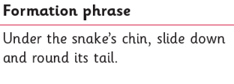
First Step
Mark making – becoming recognisable as letters.
Little Wandle formation phrases are used to help with letter formation.

Slide 12
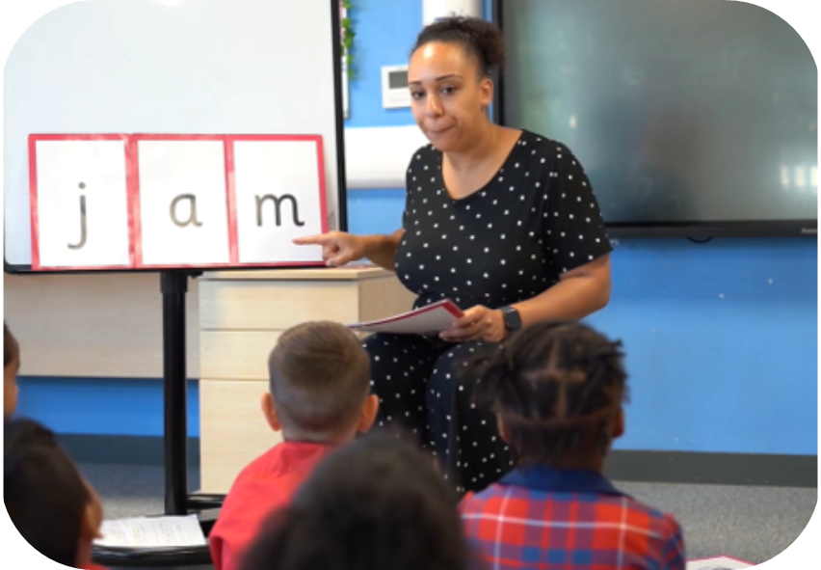
Second Step
Say the word.
Segment the sounds.
Count the sounds.
Write them down.

Slide 13
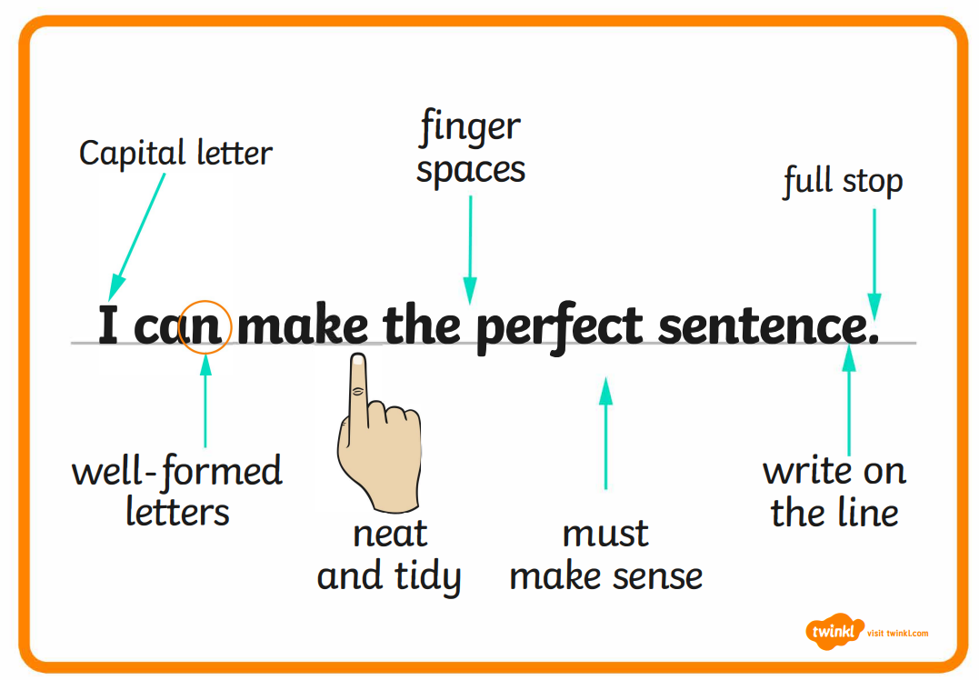
Third Step
Moving into Year One
Introducing sentences with our focus being on:
Capital letters
Finger spaces
Full stops
Aim to create a golden sentence.

Slide 14
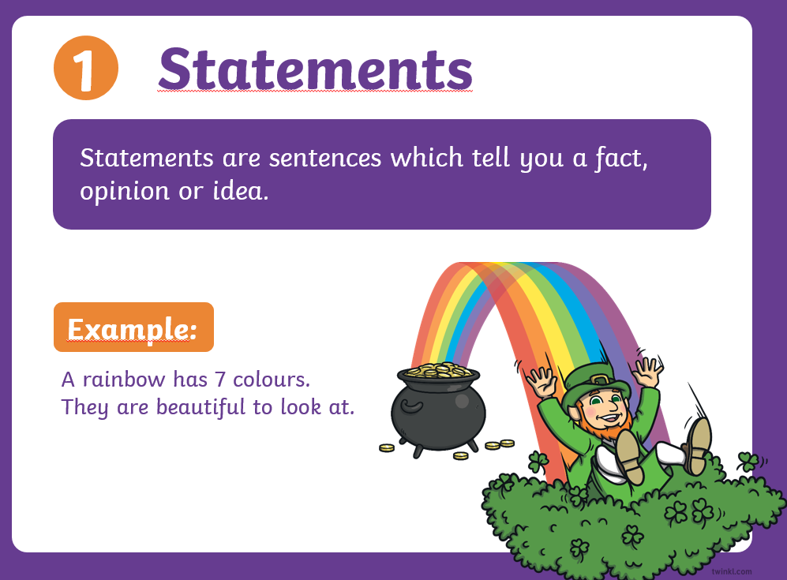
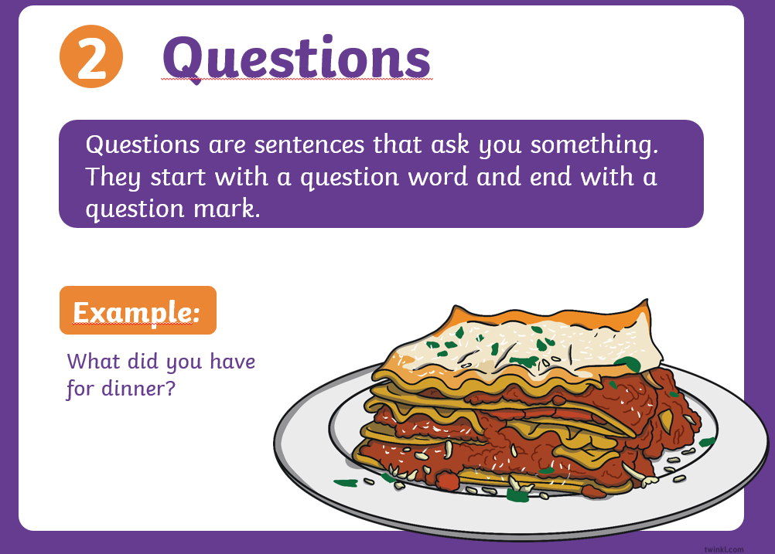
In Year 2, children develop their writing by creating different types of sentences and using them for different purposes. They learn to write 4 types of sentences; statements, exclamations, questions and commands.

Slide 15
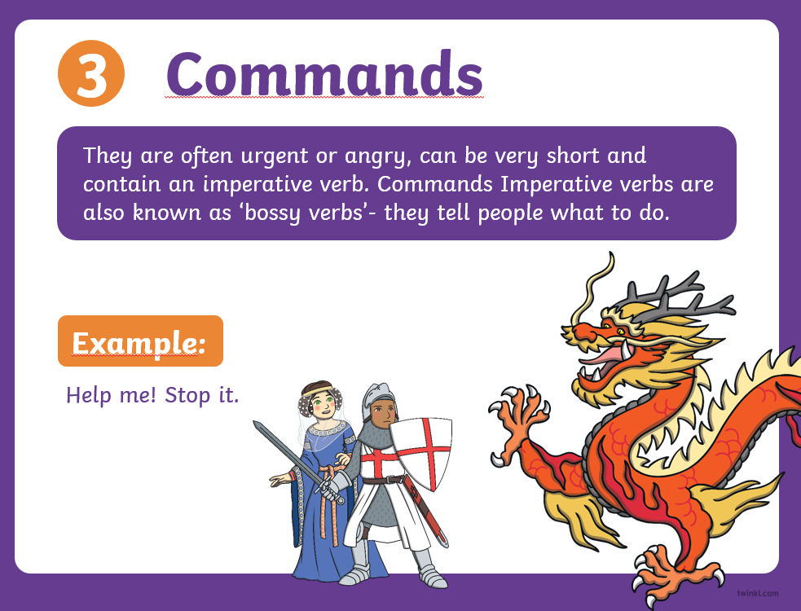
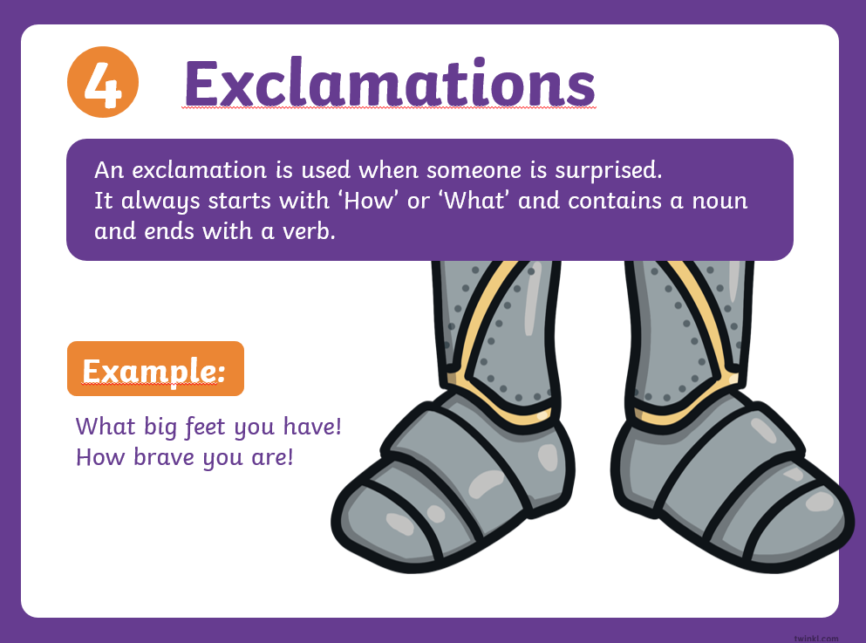

Slide 16
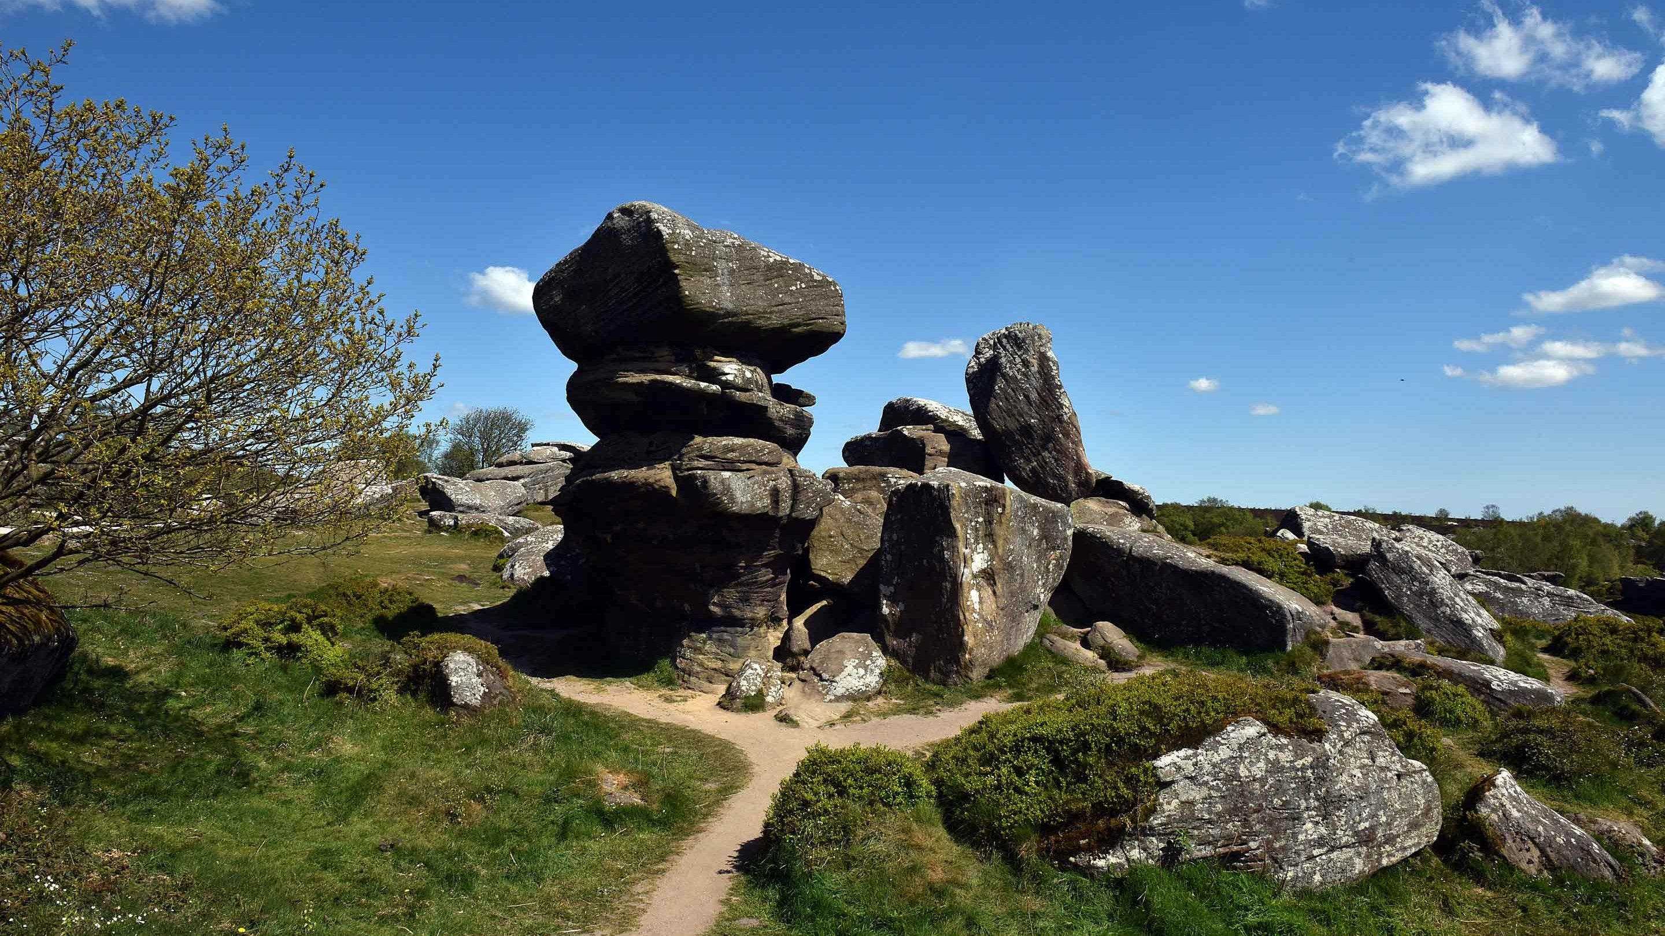
What type of sentence is it?
Statement, command, question, exclamation ?
Don’t climb on the rocks!
What a beautiful place it is!
Brimham rocks were formed 100 million years ago.
Why are the rocks such unusual shapes?

Slide 17
What does English look like in Year 3 and 4?

Slide 18
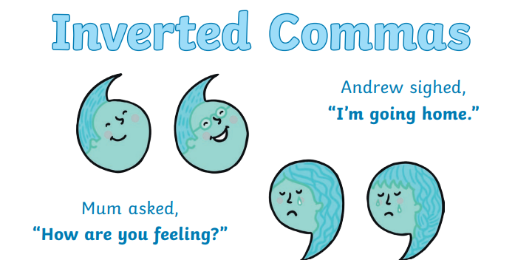
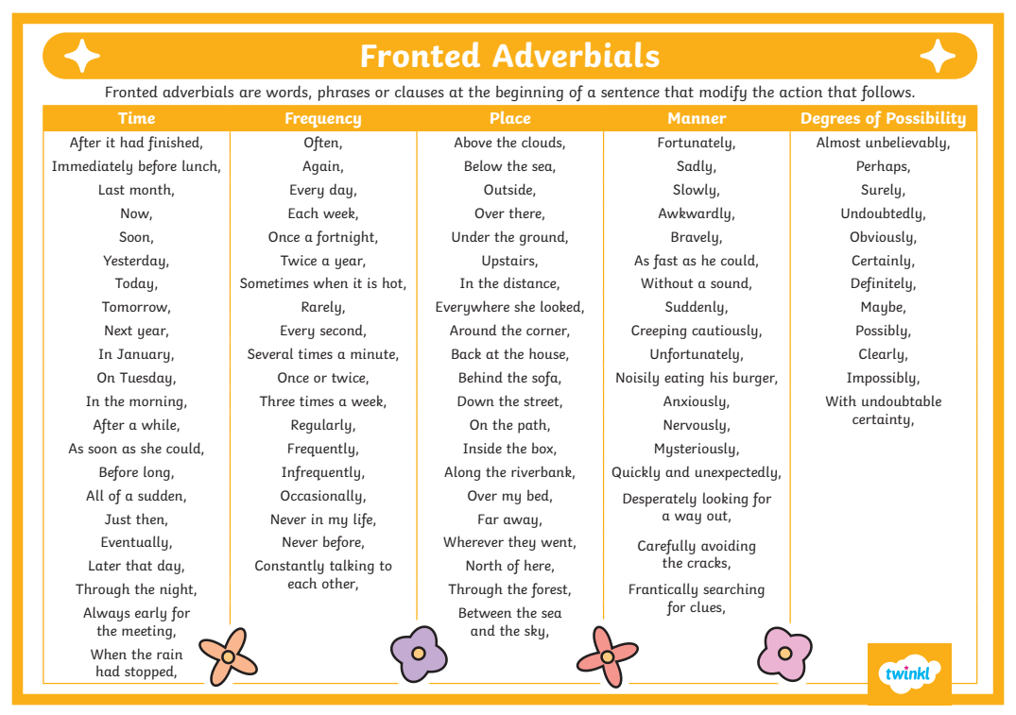
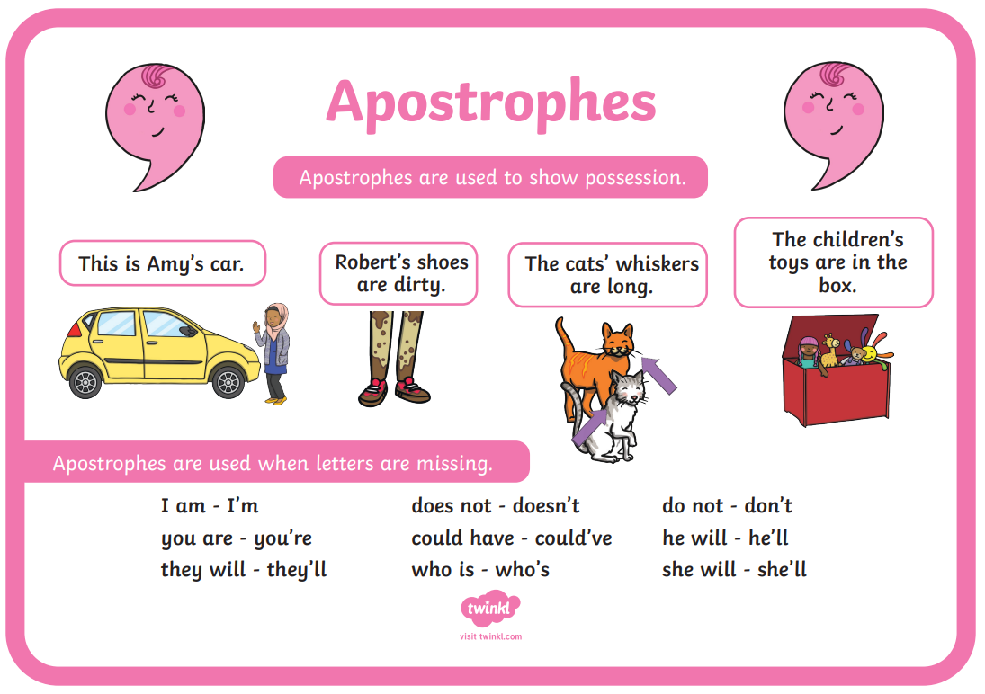
In Year 3 and 4 children continue to develop their writing and begin using more complex punctuation and multi- clause sentences.

Slide 19
Sentence Doctor
Can you add inverted commas in the correct place in the sentence below?
I want to go to bed, Miss Cameron cried.
How do children learn grammar? the parents asked.
I
"I want to go to bed," Miss Cameron cried.
"How do children learn grammar?" the parents asked.
I

Slide 20
Sentence Doctor
Where would three apostrophes go in the sentence below?
Its a shame Miss Camerons class couldnt use the laptops today.
I
IIt's a shame Miss Cameron's class couldn’t use the laptops today.

Slide 21
Sentence Doctor
Add an appropriate fronted adverbial to the start of this sentence:
__________________, we have an English lesson before break.
I
IIn the morning,
Every day,
On Tuesdays,

Slide 22
How to help your child
Encourage them to be sentence doctors in every day life. Shops, adverts and printed materials are full of grammatical errors - challenge them to find them whenever they can and begin to apply the rules they've learnt to their own writing.

Slide 23
What does a wrting lesson look like in Year 5 and 6?

Slide 24
Where do we need the pupils to be?
Transcription
Almost entirely grammatically correct, allowing for occasional punctuation and spelling errors.
Capitals, full stops, commas, apostrophes and question marks are all mostly accurate.
Uses the full range of punctuation to include evidence of dashes, brackets, hyphens, semi-colons and colons.
Handwriting should be neat, joined and legible.

Slide 25
Improving Punctuation
Improve the following sentences by adding punctuation in the correct places and correcting any spellings.
as the dragons awoke from there deep sleep they didnt notice the courageous valiant nights approaching
while creeping slowly forward the nights gauntlets tightly rapped around there sword hilts they were ready to strike

Slide 26
Improving Punctuation
As the dragons awoke from their deep sleep, they didn’t notice the courageous, valiant knights approaching.
Whilst creeping slowly forward, the knights’ gauntlets tightly wrapped around their sword hilts: they were ready to strike.

Slide 27
Improving Composition
Improve the following sentence by adding adjectives, and a relative clause.
For example:
The teacher bemoaned the lack of punctuation in the sentence.
The exhausted teacher, who had worked tirelessly, bemoaned at the lack of punctuation in the sentence.

Slide 28
Maths
Our children have a daily Maths lesson and this also comprises many elements. In Early Years and KS1 a lot of work goes into number recognition, place value and developing early skills in the four operations (addition, subtraction, multiplication and division). In Key Stage 2, mathematical understanding becomes more complex; as well as building on the fluency of the four operations, children begin to learn much more complex mathematical concepts such as algebra, fractions, decimals, percentages, co-ordinates and multi-step word problems.

Slide 29
What does maths look like in pre-school?
We are where it all begins! We are giving our children the early skills they need.
Intense focused activities
We equip the youngest of children with a love for learning because its fun and engaging
Through hands on experiences
Natural curiosity and exploration
Through daily exposure

Slide 30
What does maths look like in pre-school?
Through conversations and high quality interactions
Correct use of mathematical language
Building and adapting to a child’s interests which makes it engaging
Core provision area provided for maths which has a main focus each week
We look at numerals 1-5 only, ensuring a deep understanding of each number, using forms of representation, subitising, amounts, counting aloud etc
Environmental maths, go for a walk, count conkers, look for numbers on doors, colours of leaves and shapes of signs etc

Slide 31
More & Less learning in Pre-School
EXPOSURE! It’s always intertwined and thread through all that we do, we may count the steps as we go down to the hall, we would say 1,2 and one more 3!
You could try this at home, examples……. count the stairs, count the plates and cups, count socks, shoes etc
All resources are visually stimulating and the children have hand on experience with the resources to maintain focus.
Using hand gestures to support understanding (more-add/less-take away)
Language used ‘More’, ‘Less’, ‘Same’

Slide 32
More & Less learning in Pre-School
Ask questions such as “can you give me one more” “Which one has less?” how do you know? “3 is greater/bigger/more than 2”
The children use their skills of subitising to recognize amounts.
We show this in many ways such as with items or in water play, it will be which cup has more water, which has less, can you make them the same? An Autumn walk to collect leaves, who has more leaves in their bucket? Who has the least or less?
Repetition
Adapt on the spot and follow a child’s lead

Slide 33



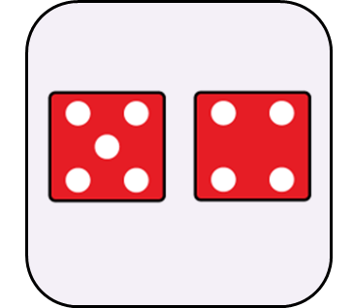

What does a Maths lesson look like in Reception, Year 1 and Year 2?

Slide 34
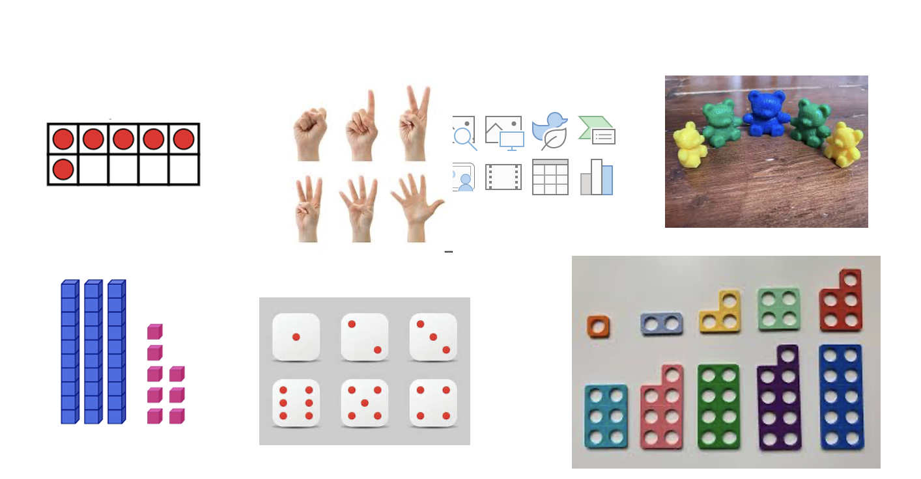

Slide 35
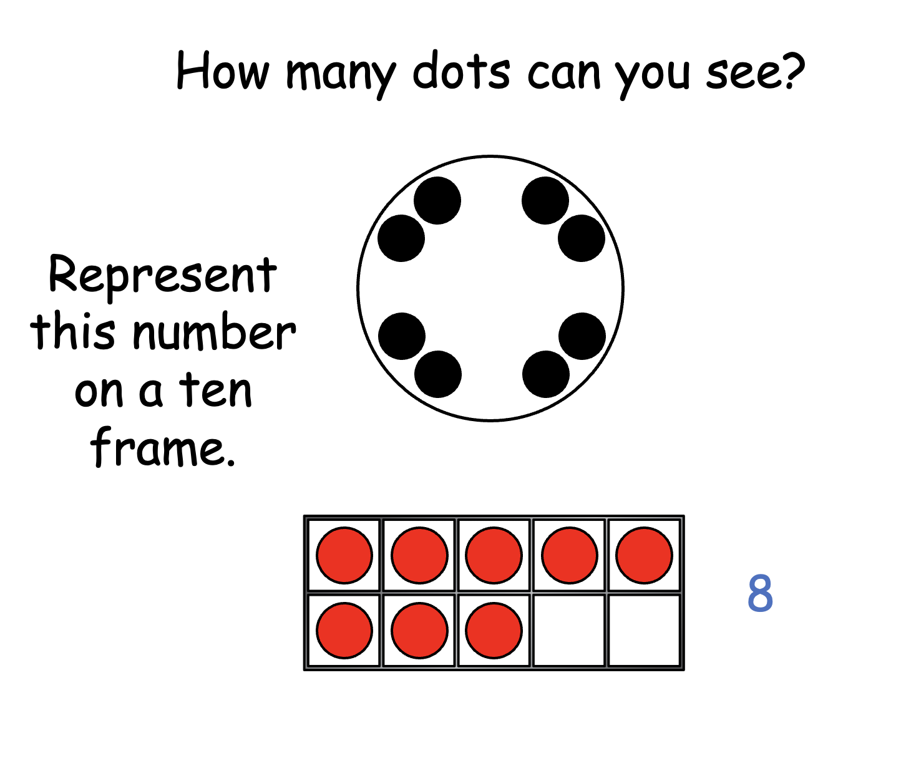

Slide 36
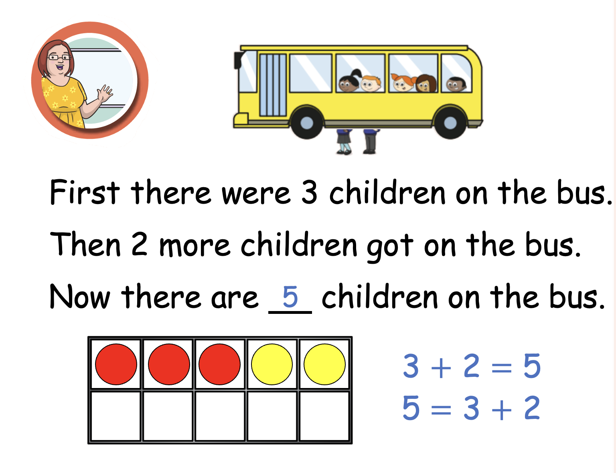

Slide 37
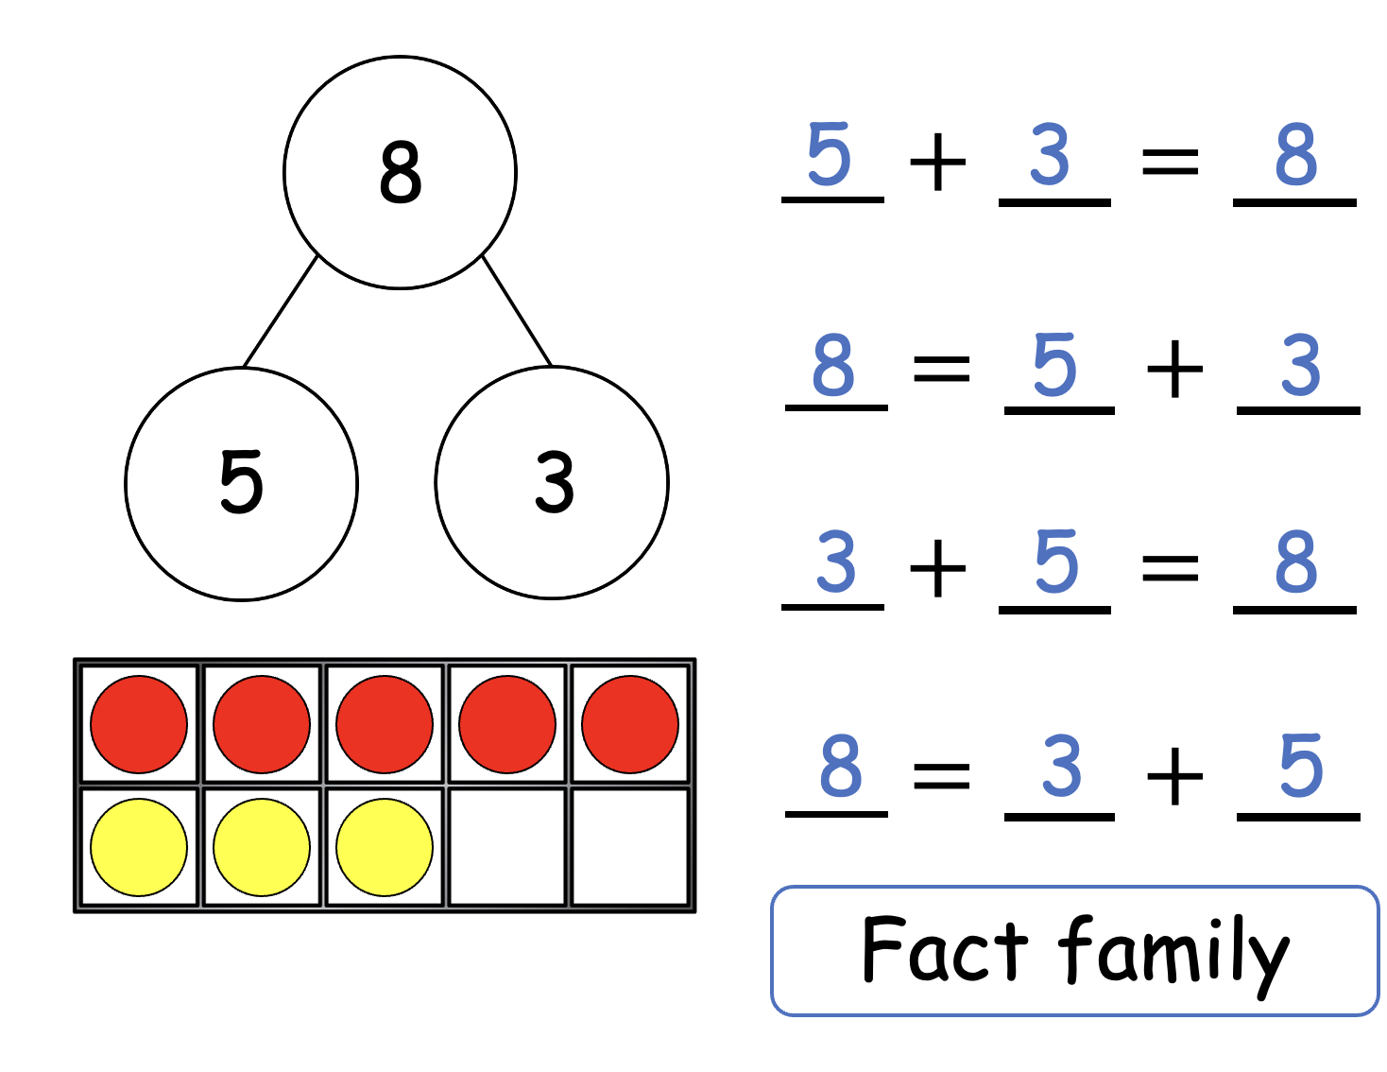

Slide 38
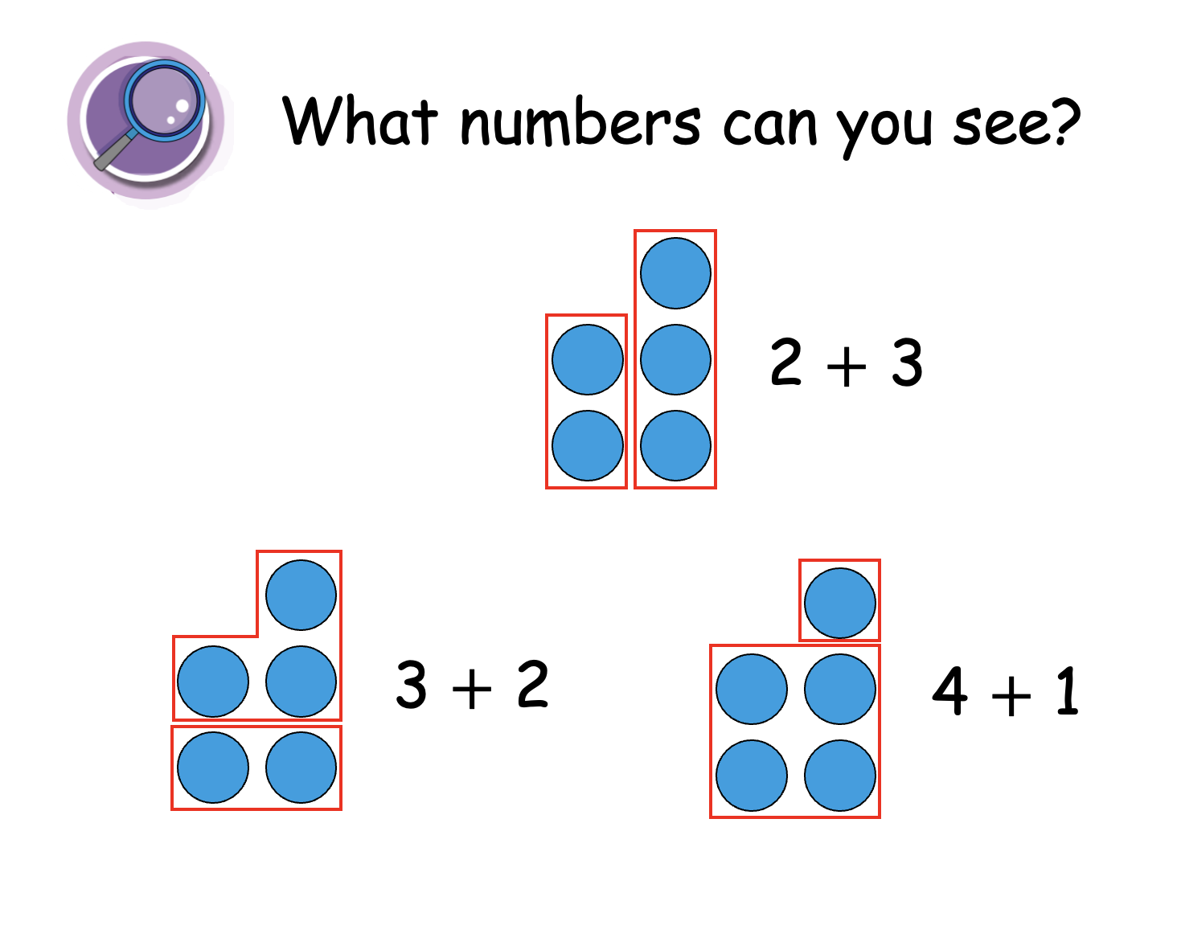

Slide 39
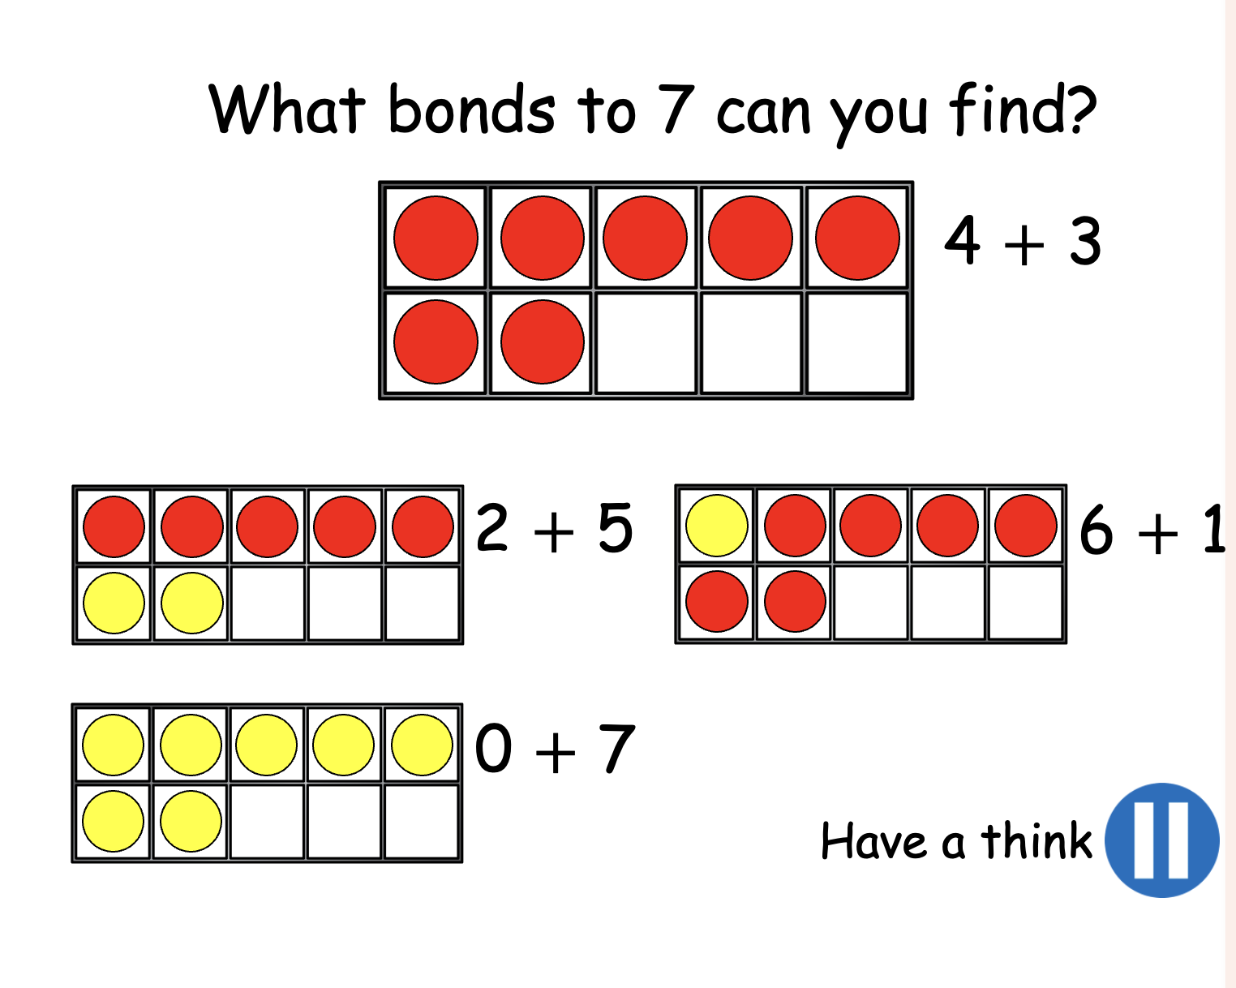

Slide 40
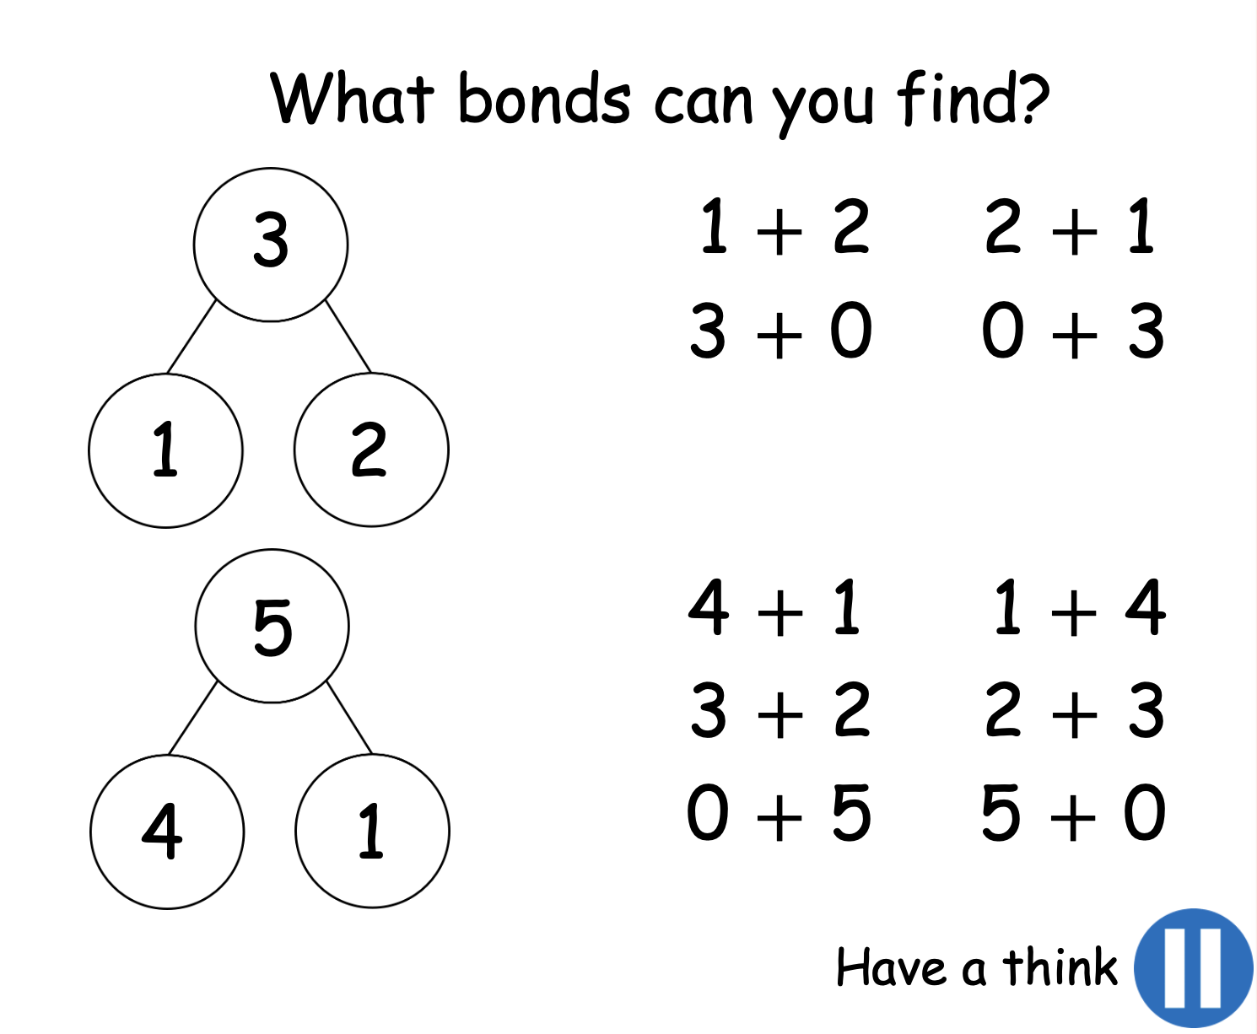

Slide 41
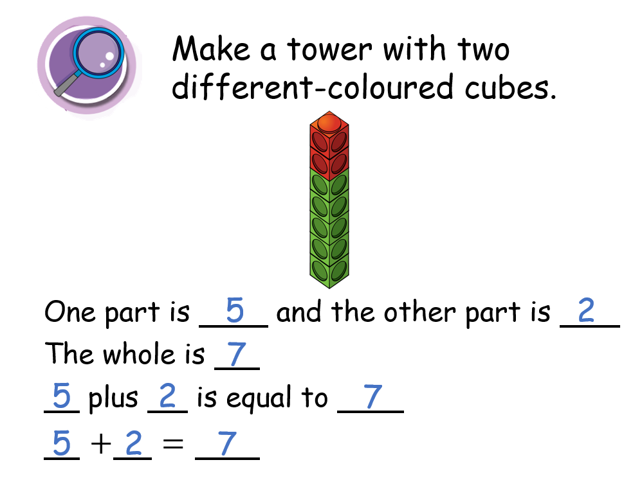

Slide 42
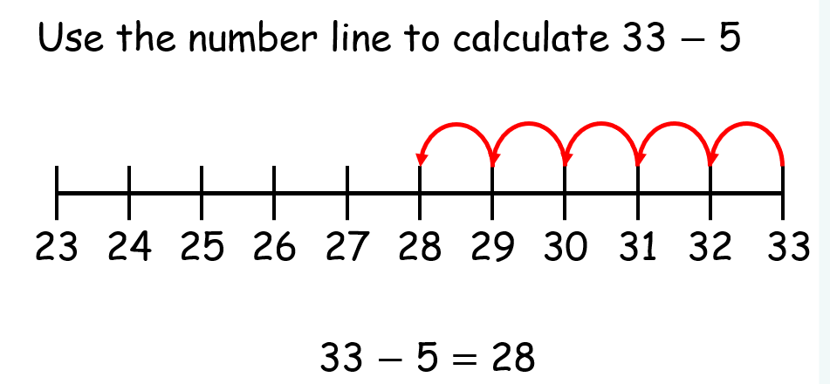
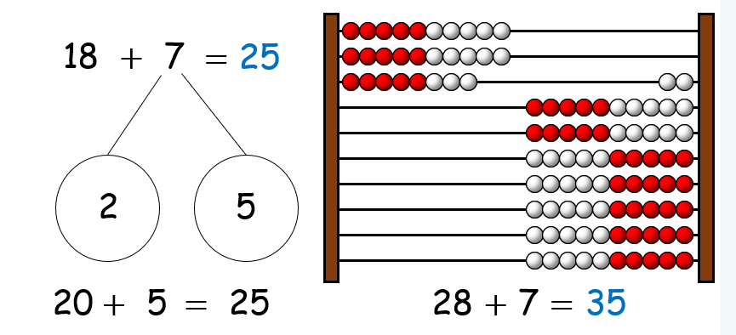
In Year Two we begin to look at numbers up to 100.

Slide 43
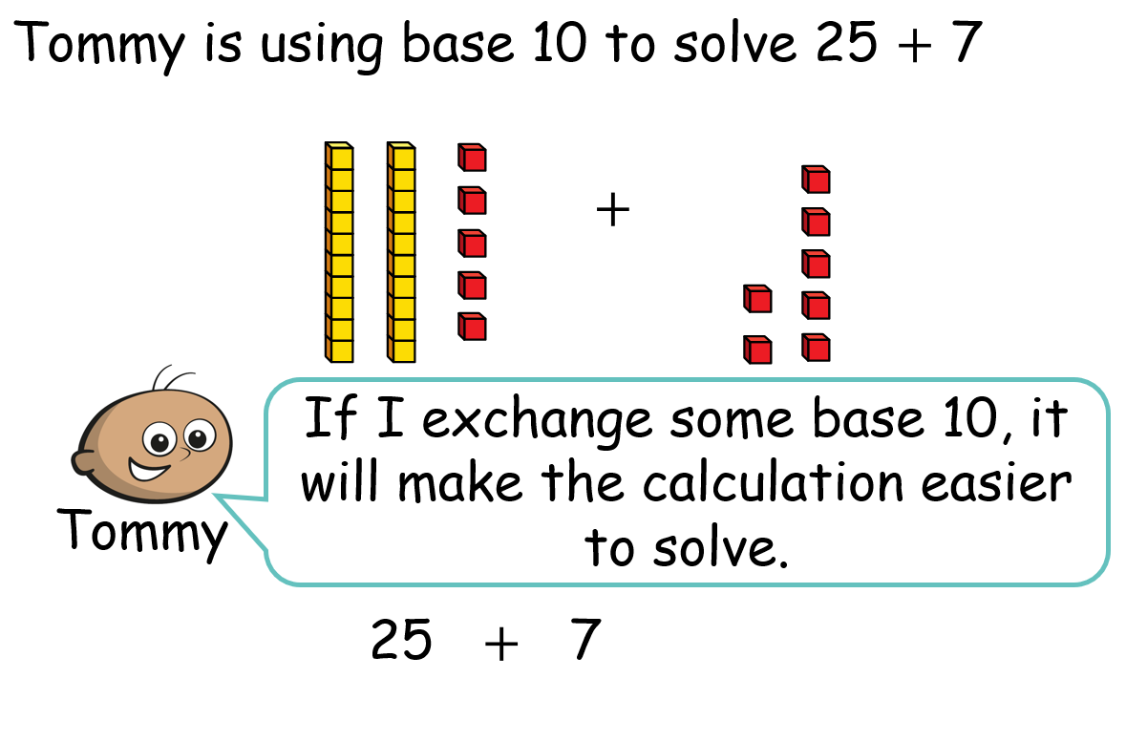

Slide 44
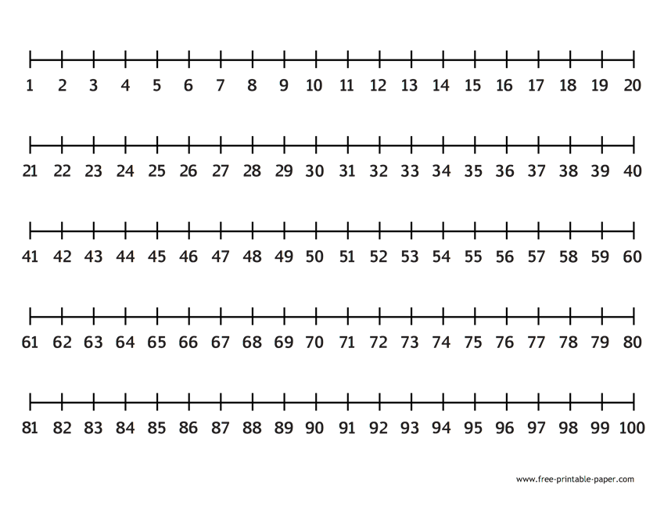
We begin, in Year 2, to look at numbers up to 100 and work towards adding and subtracting these using different methods, including number lines and pictorial representations.
We begin by looking at labelled number lines to reinforce the linear concept of number
43 + 6 =
49
72
76 – 4 =

Slide 45
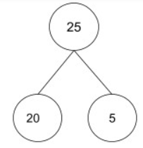
We then move on to blank number lines so that children can calculate with much larger numbers.
43 + 25 =
68
43
53
63
64
65
66
67
68
87 - 25 =
62
62
63
64
65
66
67
77
87

Slide 46
How do we teach addition and subtraction in Year 3 and 4?

Slide 47
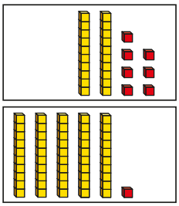
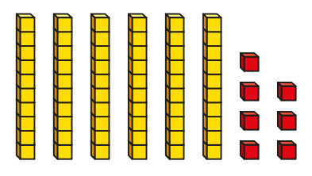
Once concrete and pictorial representations have been introduced in Year 2, we use these to support understanding of place value which leads children towards using a column to add and subtract. This is very useful for Years 3 and 4 who would use these representations to add and subtract 3-digit and 4-digit numbers.
27 + 51 =
78
67 - 21 =
46
40
6
70
8

Slide 48


243 $+$ 172 $=$
415
Hundreds | Tens | Ones
 | H | T | O
 | 2 | 4 | 3
 | 1 | 7 | 2
$$+$$
4
1
5
1
4
11
5
1

Slide 49




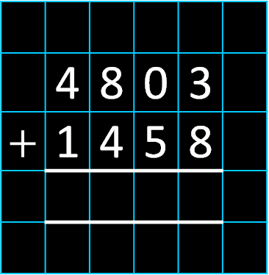
Th | H | T | O
 | 4 | 8 | 0 | 3
$+$ | 1 | 4 | 5 | 8
6
2
6
1
1
1
6
2
6
1

Slide 50
What does an addition and subtraction lesson look like in Year 5 and 6?
In upper key stage 2, we build on the skills taught in the younger classes. We continue to use the practical resources but begin to move to a more pictorial and written method of calculation. In Year 6, in preparation for SATS, there is a strong emphasis on using a range of addition and subtraction methods to solve problems, including multi-step problems.

Slide 51
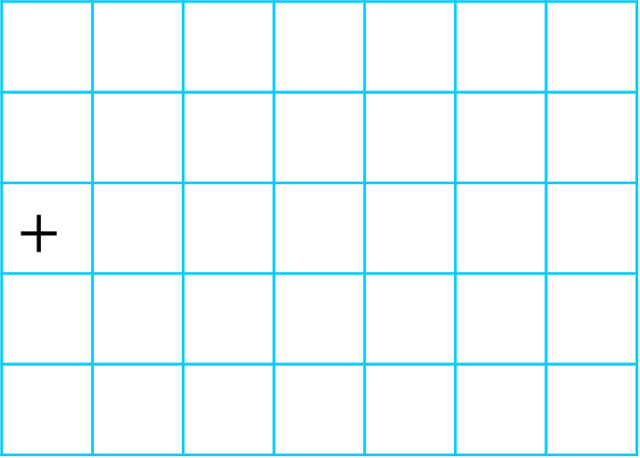

The table shows the number of sweets a factory makes within a week.
How many sweets were made on Tuesday and Friday?
Day | Number of sweets
Monday | 394,792
Tuesday | 68,805
Wednesday | 145,256
Thursday | 1,309,078
Friday | 23,702
 | 6 | 8 | 8 | 0 | 5
$$+$$ | 2 | 3 | 7 | 0 | 2
9
2
5
0
7
1
1
92,507 sweets
68,805 $+$ 23,702 $=$

Slide 52


On Monday, Dexter scores 411 points.
On Tuesday he scores 63 points fewer than on Monday.
How many points does he score on Tuesday?
348
Monday
411
H | T | O
4 | 1 | 1
 | 6 | 3
3
1
63
0
Tuesday
348
?
1
$$−$$
3
4
8

Slide 53
On Monday, Dexter scores 411 points.
On Tuesday he scores 63 points fewer than on Monday.
How many points does he score on Tuesday?
348
Dexter needs to score 1,000 points by the end of Wednesday to win a prize.
How many points does he need to score on Wednesday?
H | T | O
4 | 1 | 1
3 | 4 | 8
1,000
M = 411
T = 348
W = ?
+
7
5
9
759

Slide 54
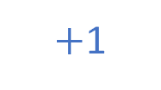
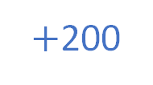
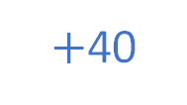
On Monday, Dexter scores 411 points.
On Tuesday he scores 63 points fewer than on Monday.
How many points does he score on Tuesday?
348
Dexter needs to score 1,000 points by the end of Wednesday to win a prize.
How many points does he need to score on Wednesday?
241
$+$1
$+$40
$+$200
1,000
M = 411
T = 348
W = ?
759
760
800
1,000
759

